Slide 1
Global Launch of New
International Research Program
on Informal and Shared Mobility
12 December 2023 – Welcome!

Slide 2
Welcome to the New International Research Program on Informal and Shared Mobility!
Equity, Ecosystems and Engagement for Transformation

Slide 3
Overview: Evidence-Based Transformation!
Equity: focus on lower income, underserved communities & vulnerable populations for equality of access, high quality service and opportunity, climate, environmental & social justice (emissions)
“Ecosystems”: livelihoods, labor, businesses, government, civil society, norms, technologies as a ISM ecosystem that must be understood within a context of power for change
Engagement: with global policy and investment decision-making and locally including via an urban living labs approach and co-creation for tangible improvements in service, equity & emissions reductions & health benefits

Slide 4
7 LIVING LABS
LIGHTNING TALKS
ACCRA & KUMASI, BANGKOK, BEIJING, BOGOTA, CAPE TOWN, MUMBAI, SAN JOSE

Slide 5
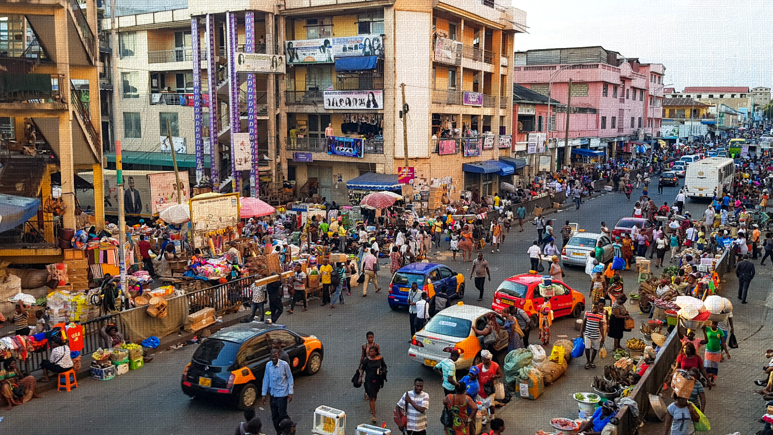
ACCRA & KUMASI, GHANA
https://www.cfhi.org/program/global-health-in-ghana-accra/

Slide 6
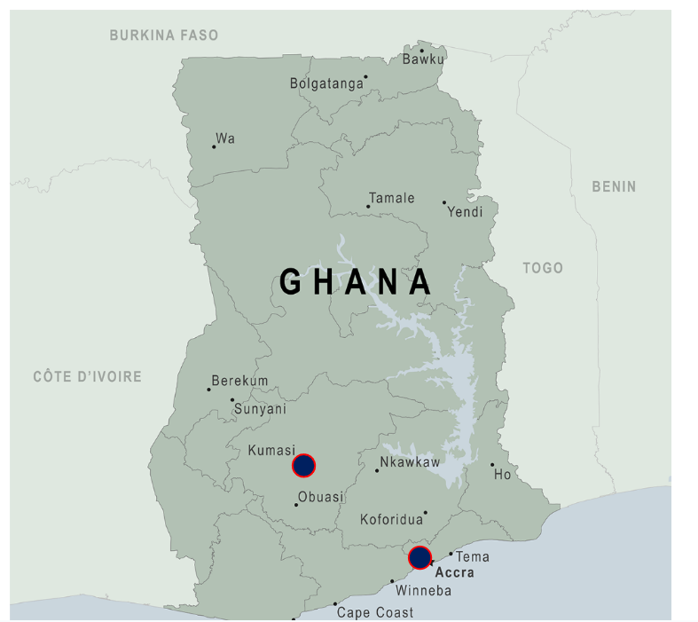
Synergizing Transport for Equitable Mobility and Accessibility in the Context of Emerging Technologies and Informality: Learning from Ghana
Core Research Team
Ransford A. Acheampong (University of Manchester)
Ernest Agyemang (University of Ghana)
Festival Godwin (University of Oxford)

Slide 7
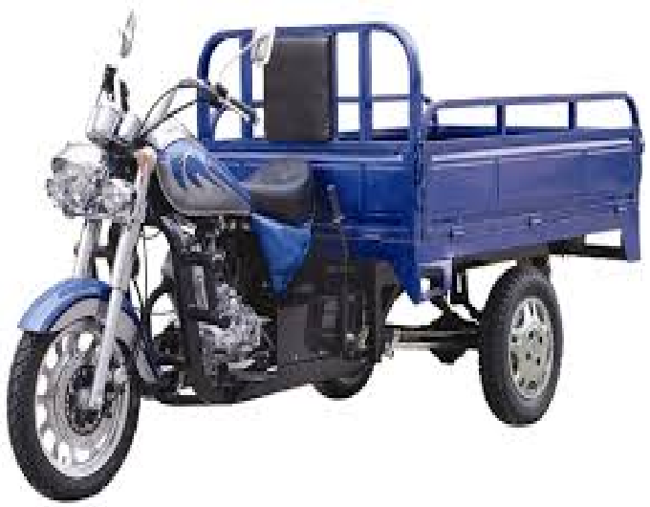
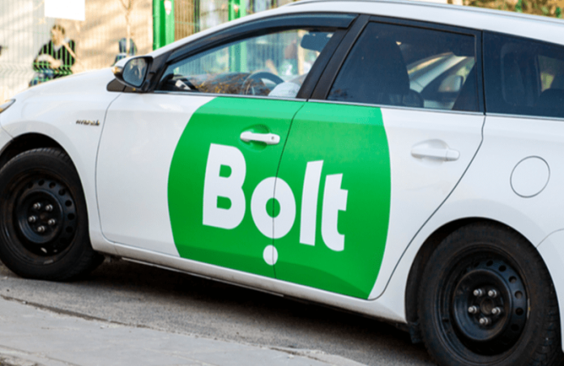
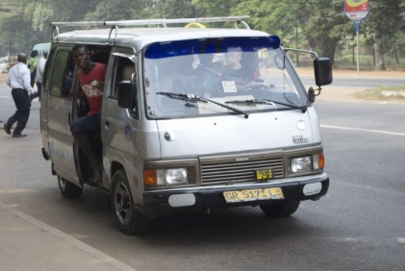
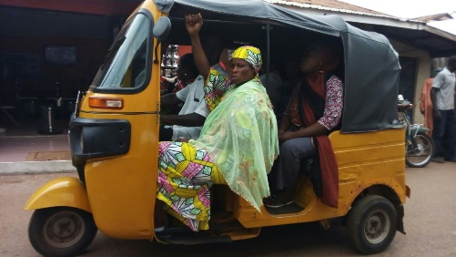
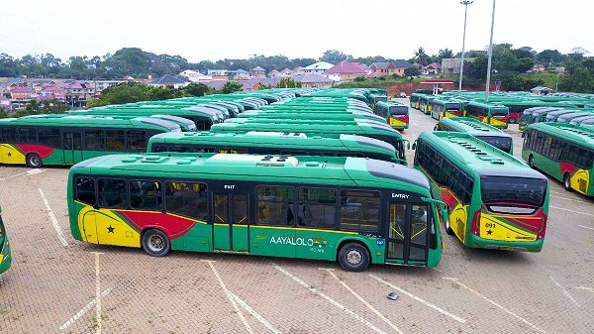
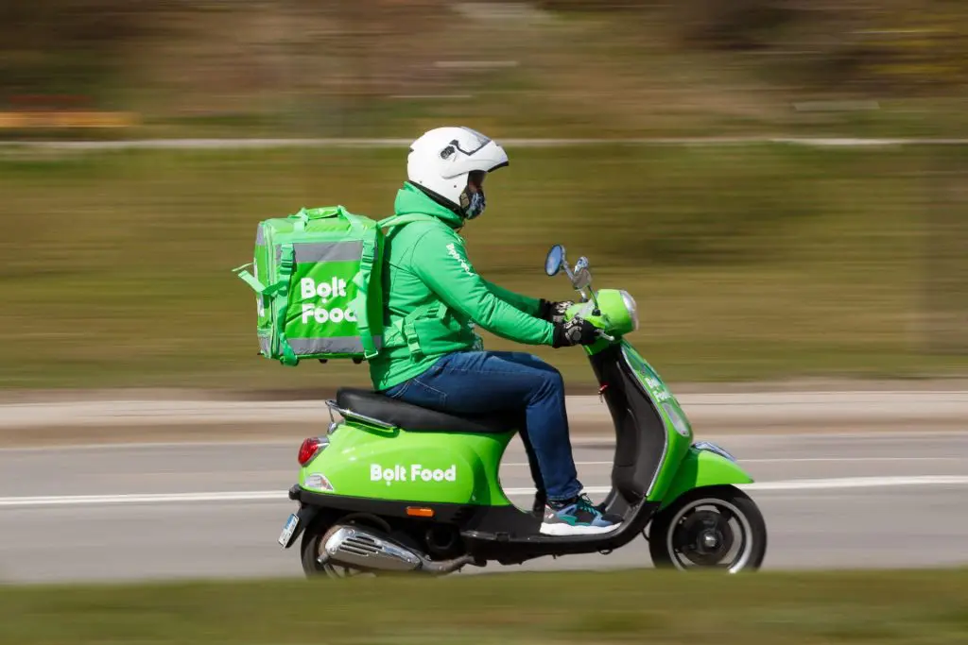
Context
Evolving Ecosystem
Conventional ‘informal’/ ‘popular’ transport (Trotro, Taxi)
Public sector interventions (MMT, BRT etc.)
Growing presence of other forms of ‘micro-transit’
Emergence of ICT-mediated, digital platform mobility services (Uber, Bolt etc)
Complex, highly political and contested ecosystem of modes, services and actors (operators, workers, public sector institutions, passengers, etc.)

Slide 8
Ultimate goals
Explore, co-produce and demonstrate innovative pathways and strategies to synergize conventional and new ICT-mediated mobility solutions to ensure equitable and socially just mobility and accessibility
‘Coalition building’ for reforms and transformative action by fostering constructive dialogue among the complex network of actors
Create knowledge and generate new policy-relevant insights in three key interrelated areas:
systematic, comparative analysis of the emerging transport and mobility landscape and policy and governance responses in the face of pervasive digital technologies
assessment and evaluation of impact—how different modes of digital/app-based mobility services interact with existing ‘informal’/ ‘popular transport’ options to address mobility and accessibility challenges
identify the political, policy, institutional and technical conditions necessary to achieve integration between new forms of ICT-mediated mobility and conventional informal public transport

Slide 9
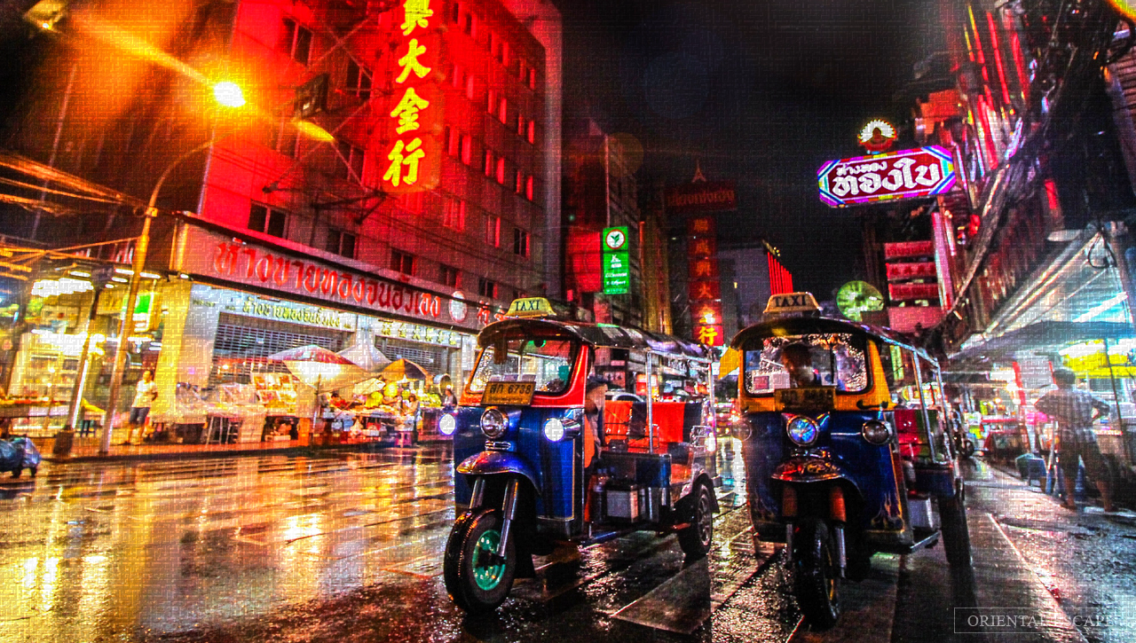
BANGKOK, THAILAND

Slide 10
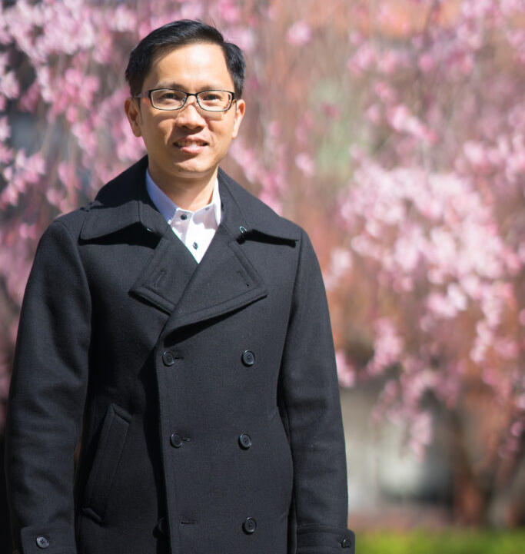
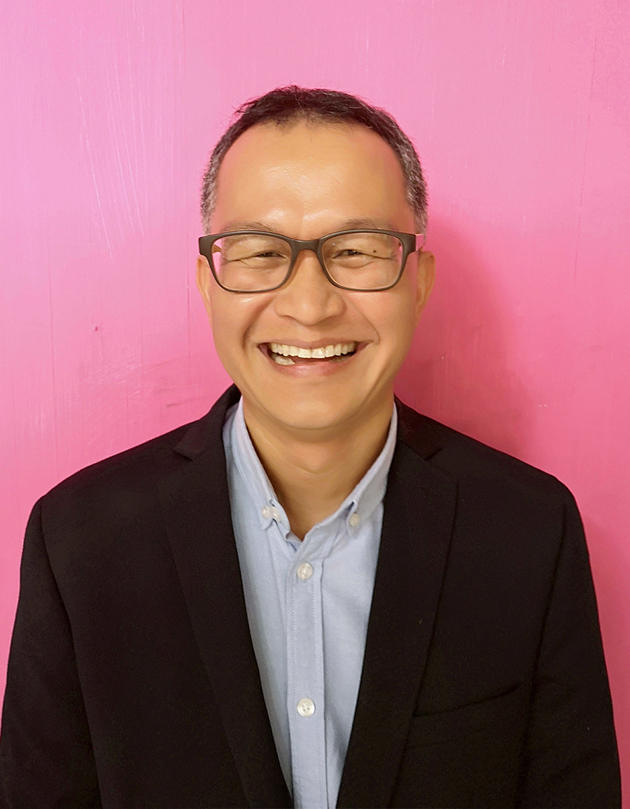
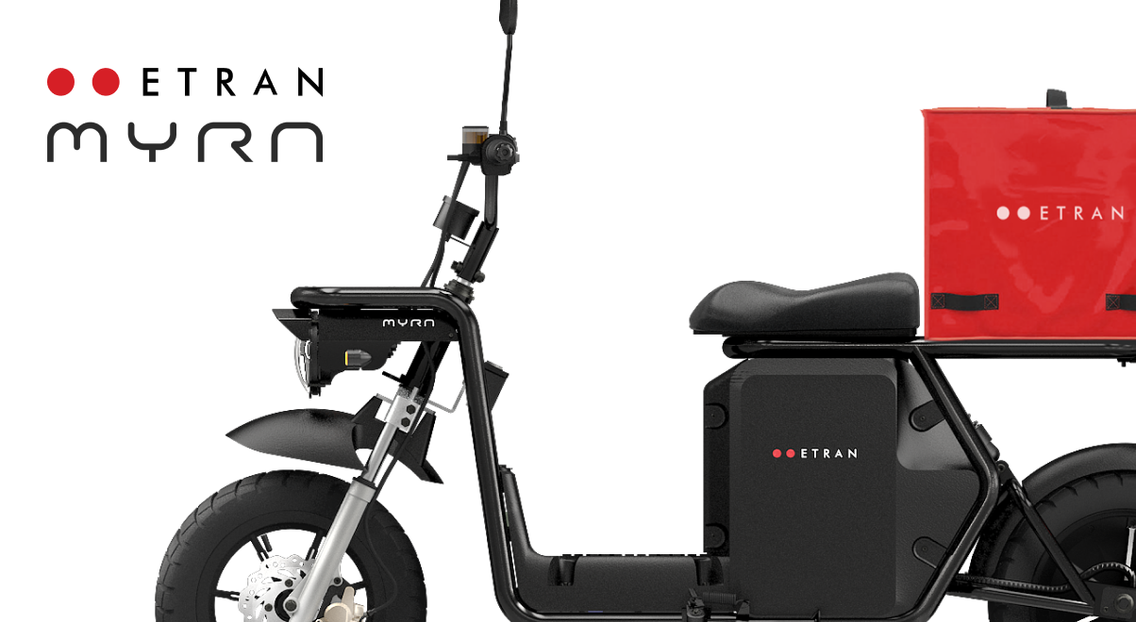
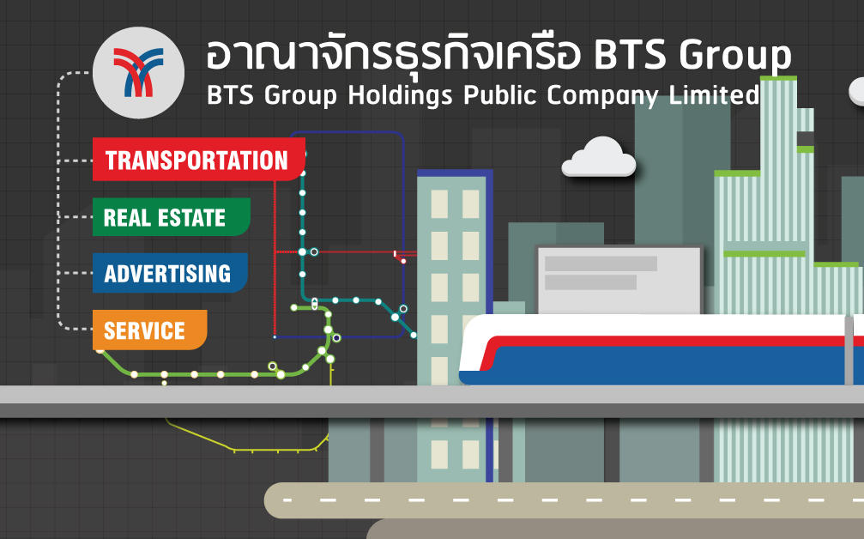
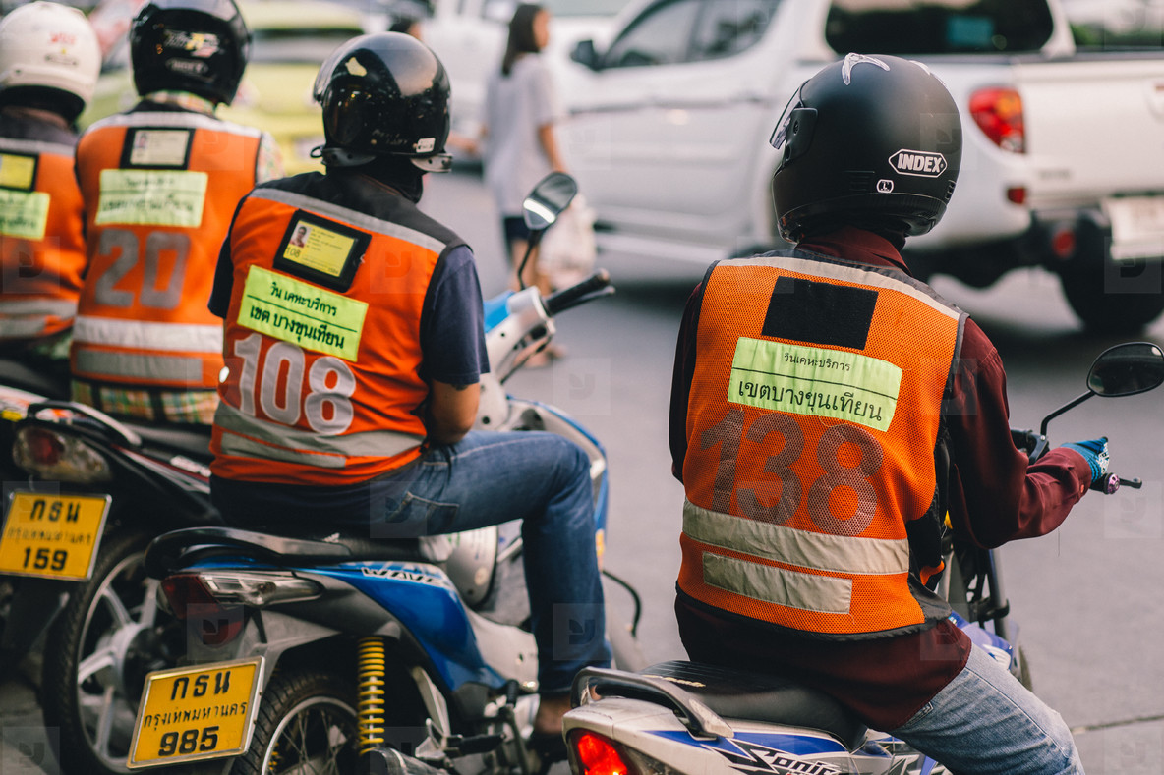
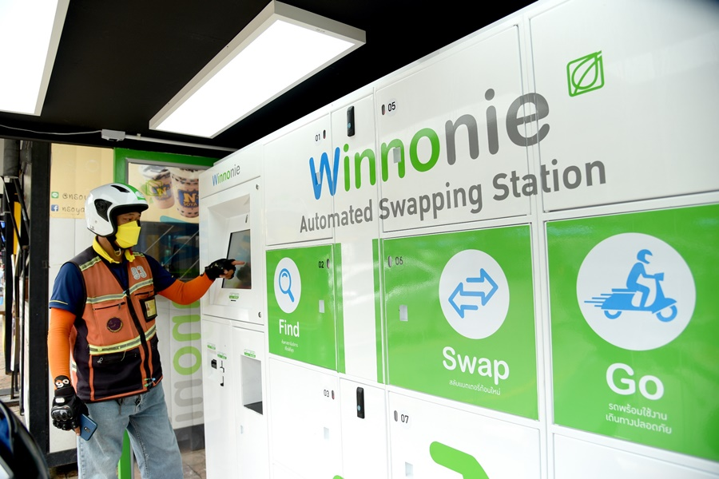
Bangkok Living Lab Team
Saksith “Tan” Chalermpong
Deputy Director
Chulalongkorn University Transportation Institute
Lisa Kenney
Researcher
Chulalongkorn University
Transportation Institute
Ornicha “Nui” Anuchitchanchai
Researcher
Chulalongkorn University Transportation Institute
Apiwat “Ton” Ratanawaraha
Dept. of Urban and Regional Planning
Center for Science, Technology, and Society
Chulalongkorn University
Engaged Stakeholders

Slide 11
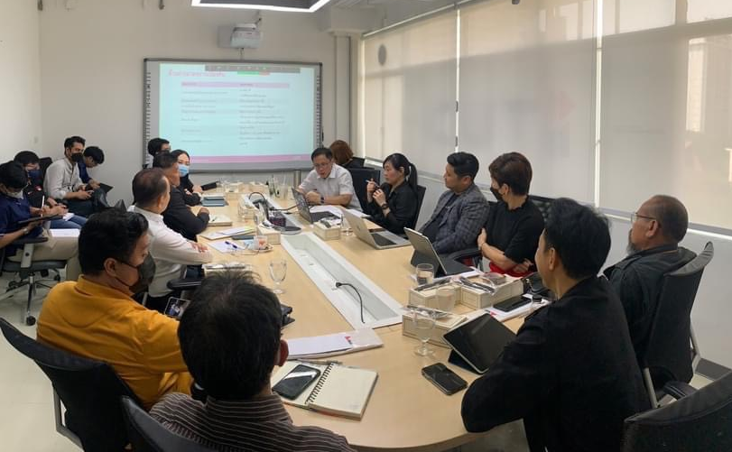
Bangkok Living Lab: Electric motorbike taxis as part of
low-carbon popular transport
Bangkok residents rely on nearly 90,000 motorbike taxis as part of the popular, informal transport system. While personal electric vehicle infrastructure, incentives and policies are largely in place, there remains a need to better support the conversion of motorbike taxis to electric motorbikes (EMs) in terms of infrastructure, regulations, and overall governance.
Obstacles to electric motorbike taxi conversion:
Current vehicle registration regulations prohibit shared/rental taxis, or bikes without a permanent battery
Redundancy of tax charges on imported batteries
Insufficient battery swapping or charging infrastructure
Drivers’ lack of knowledge about EMs, especially maintenance
Finance, refinancing, reselling, and insurance is difficult to attain
Stakeholder Workshop March 2023

Slide 12
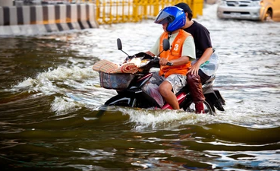
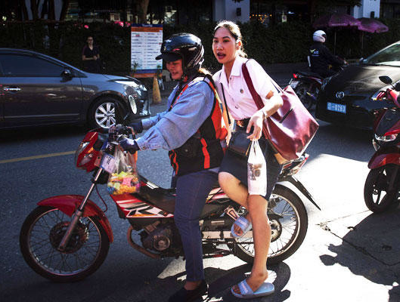
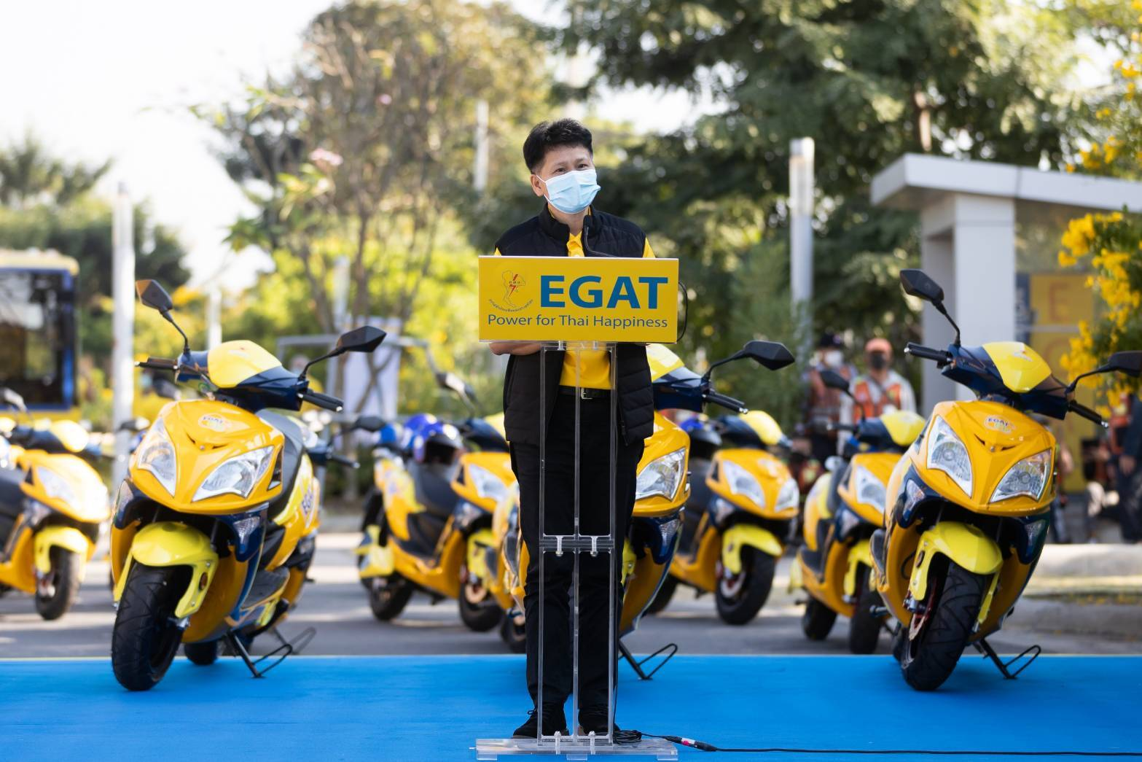
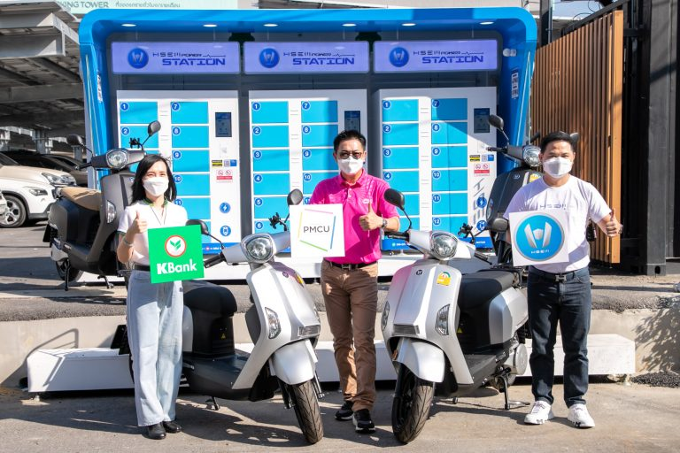
Bangkok Living Lab Approach
“Governance as an Endogenous Factor”
The Bangkok Living Lab will act as a space to engage and coordinate stakeholders involved in ongoing EM pilots and research to help inform governance and institutional frameworks for the successful transition to a sustainable, low-carbon electrified motorbike taxi system. We will take into account social implications (driver income, cost of operation, passenger), equity issues (older drivers and passengers, and female drivers), and environmental implications (air quality, battery disposal, resilience to climate issues like flooding and heat).
Research Steps + Methods
Assess the current governance ecosystem frameworks for EMs
Bring together stakeholders in focus groups and workshops to map ongoing EM initiatives
Utilize participatory research and design to identify governance needs and create new institutional frameworks

Slide 13
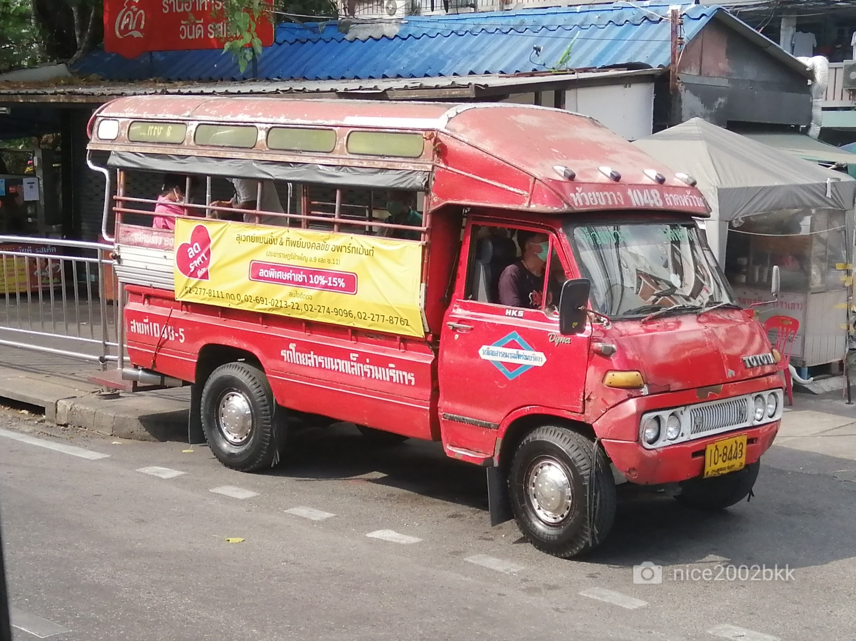
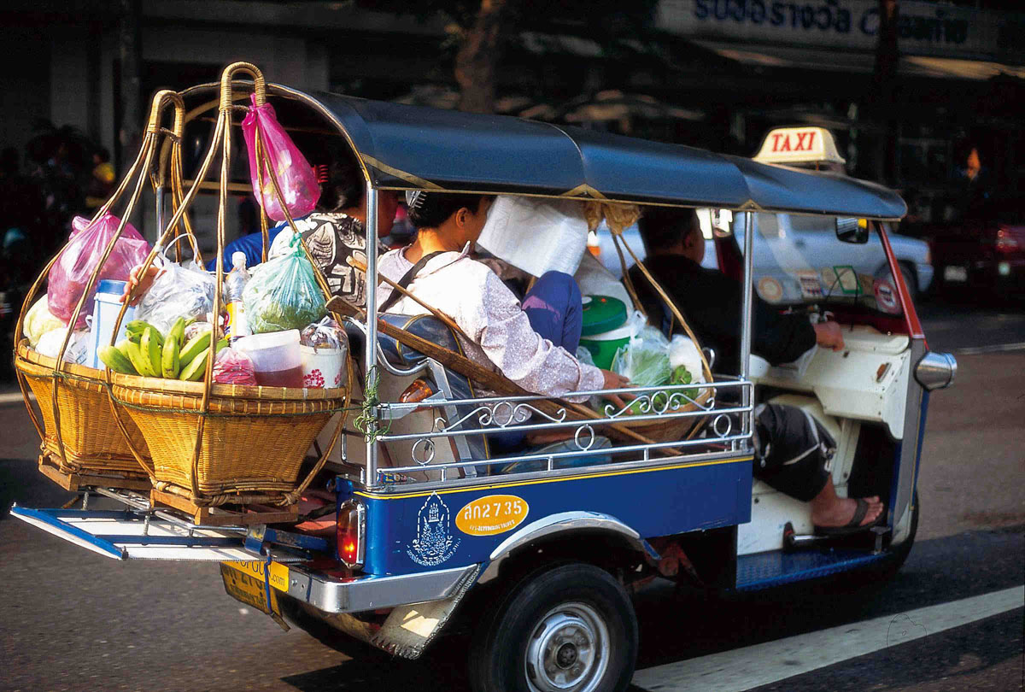
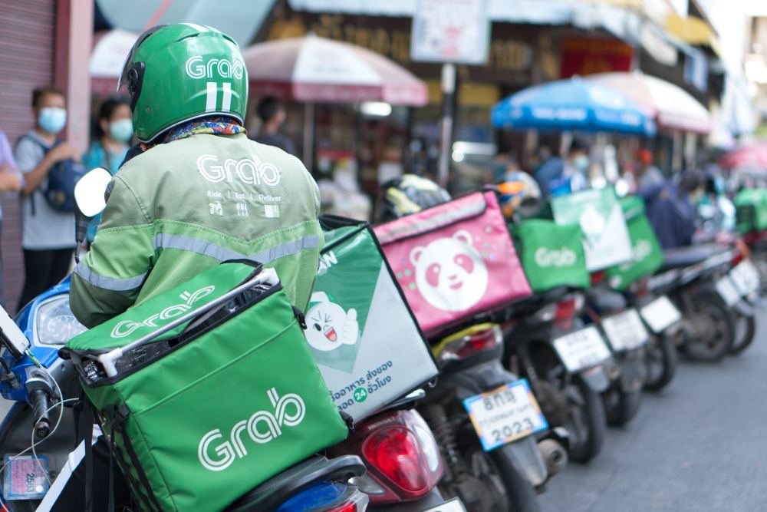
Bangkok Living Lab: Why is this important?
Without adequate governance in place, a sustainable, low-carbon transition cannot succeed for other popular informal transport modes like tuk-tuks, minivan taxis, and delivery motorbikes in Thailand
Lessons learned from the Bangkok Living Lab can be applied to these other modes of transport
The Bangkok Living Lab approach can be applied in other SE Asian countries, and parts of the Global South with similar transport systems

Slide 14
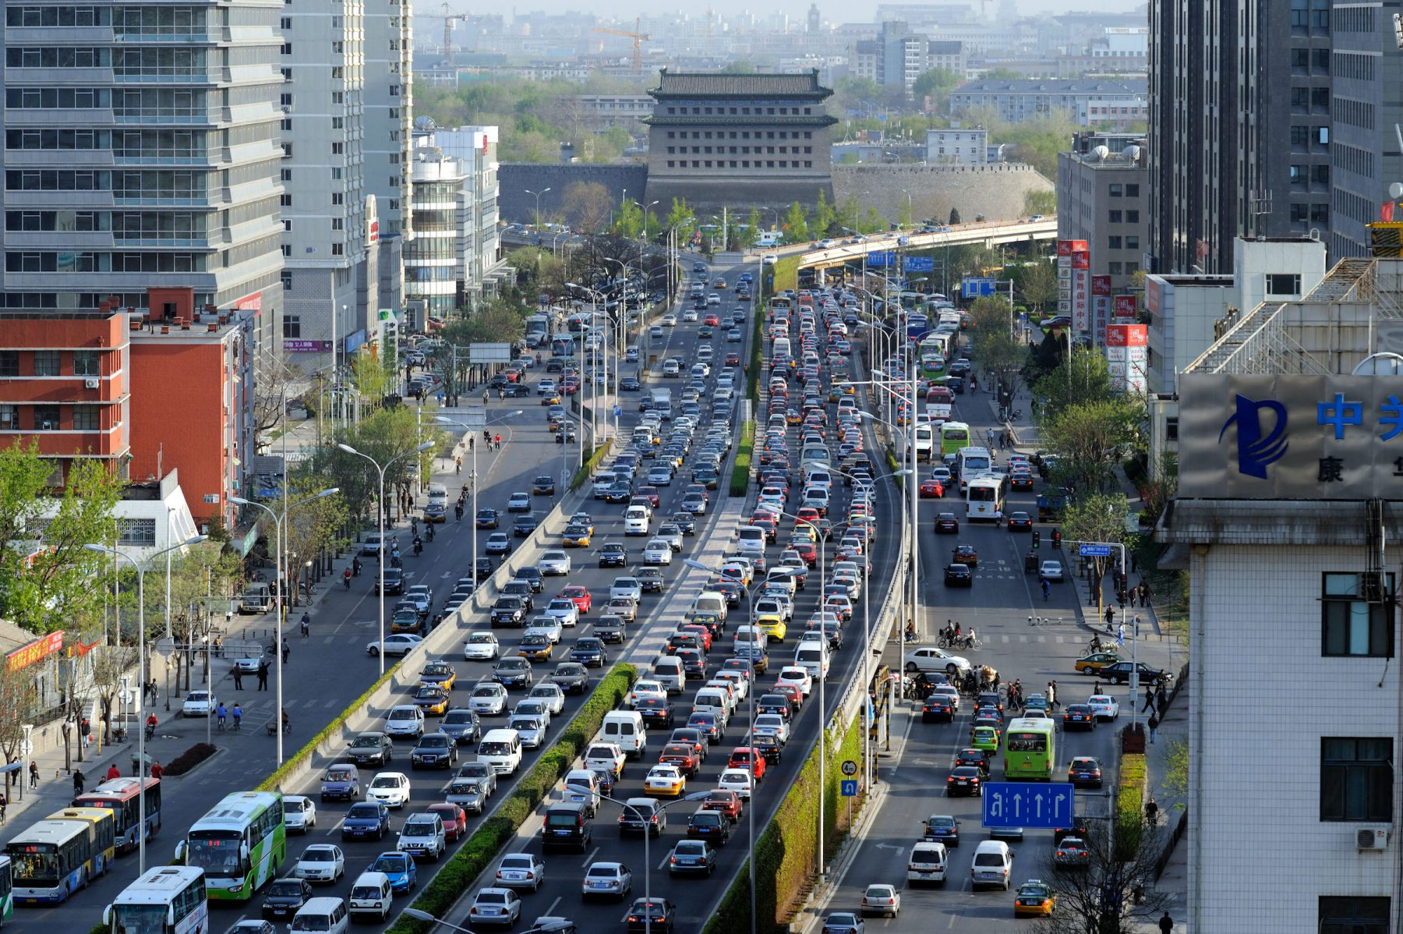
BEIJING, CHINA
(Image: Alamy)

Slide 15
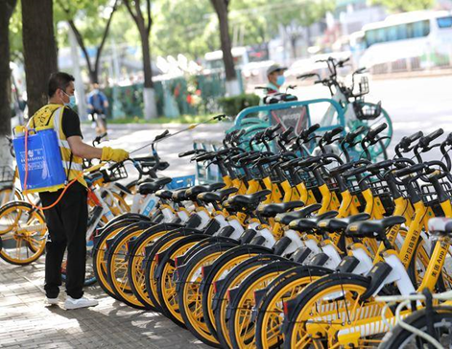
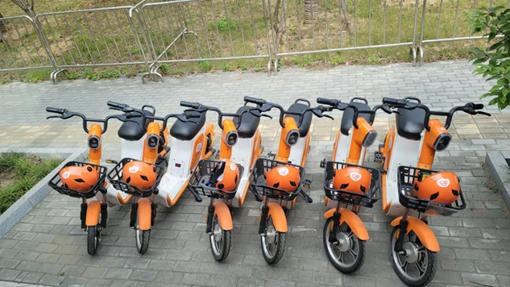
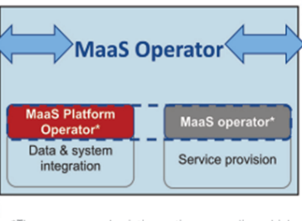
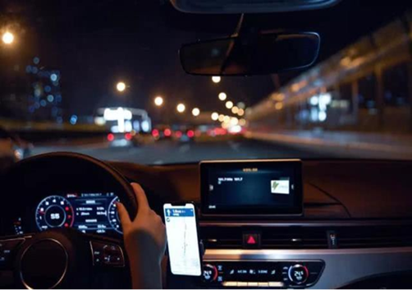
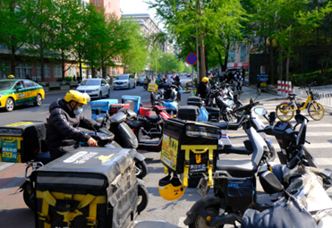
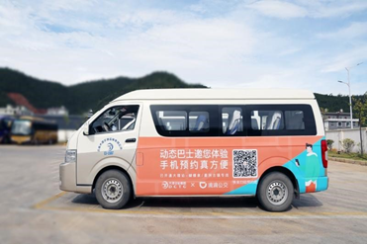
Living Lab Beijing: - Green MaaS and Shared Mobility in Beijing –

Slide 16
Living Lab Beijing: Members and Partners
Su Song, WRI China
Xuehong Ji, North China University of Technology
Yilin Ma, Beijing Transport Institute
Benjamin Welle, WRI
Thet Hein Tun, WRI
Next generation scholars: PhD/Master candidates from NCUT and other research institutes (to be identified)
Other partners from Gaode Map, HelloBike, Didi, Meituan, CATS, RIOH, etc.

Slide 17
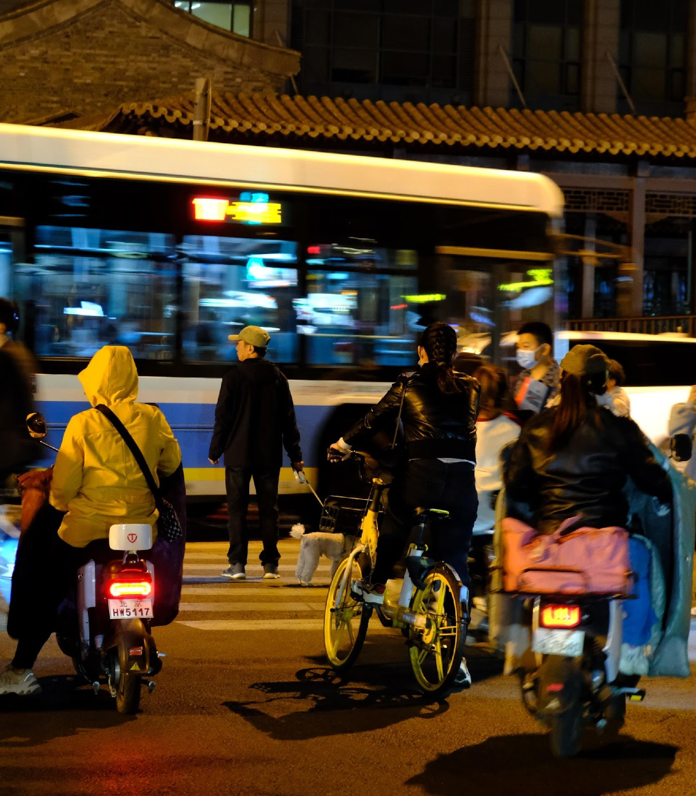
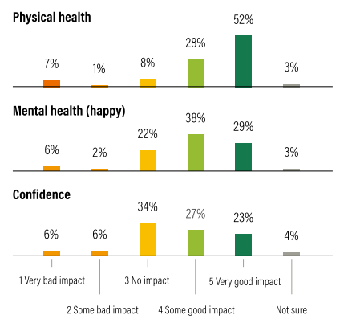
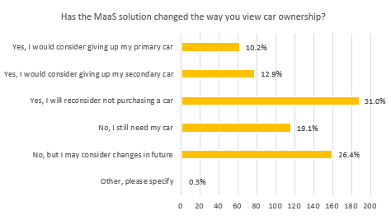
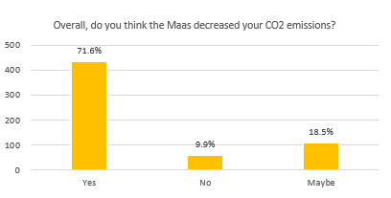
Gaps and potentials in China’s shared mobility services
Equity (esp., disabled, lower-incomes, elderly, children, etc.)
Climate resilience
Health impact assessments
Life-cycle environmental assessment
Road safety
Legislations, regulations and policies
Economic and social impacts, e.g., access to job, educational, economic opportunities, users welfare.
Source: WRI (2022), *Ongoing project, not ready to quote.

Slide 18
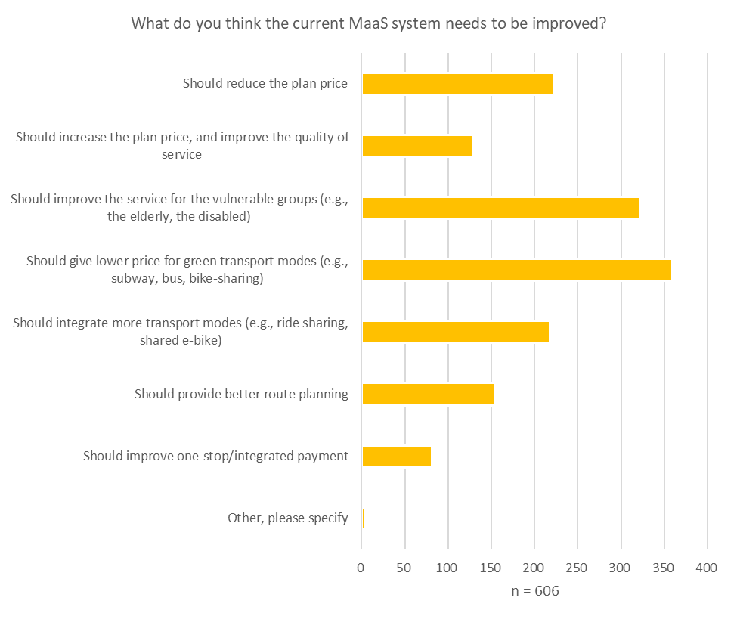
Living Lab Beijing: Key Areas
Impact Assessment Research
Next Generation
Policy Database and Comparative Studies
Living Lab Beijing
Green MaaS Seminar
Biennial China Shared Mobility Review
Green MaaS practices in Beijing and other cities
Source: WRI (2022), *Ongoing project, not ready to quote.
Notes:
Impact assessment research: Identify and establish indicators and evaluate the costs/benefits of informal and shared mobility (e.g., bike sharing) and relevant policies from 20 Chinese cities using a survey and consultation approach. The impact assessment will cover the indicators of social (e.g., equity, physical and mental health through active transport, accessibility, safety), environmental (e.g., carbon reduction, air quality, climate resilience), and economic (e.g., financial sustainability of the shared mobility system, job and economy accessibility, level of service) aspects. [Output: report and/or peer-reviewed paper produced in 2024]
Policy and governance comparative analysis: Provide in-depth case studies (e.g., Beijing) of shared mobility in Chinese cities for comparative analysis, particularly in terms of policy, regulation and governance for bike sharing and other modes of informal shared mobility. Examples include understanding the mechanism and impacts of fleet control (to avoid oversupply), parking management (to avoid parking chaos and road safety), infrastructure and technology improvement, pricing, etc in different Chinese cities. [Output: excel-based and/or online database, updated annually between 2023-26]
Biennial shared mobilities review: Working with the partners, we will biennially review the shared mobilities status, challenges, development, and research in China. The review engages writers from academia, industry, and government. [Output: Bi-ennial Bluebook of Shared Mobility Development in China, published in 2023 and 2025]
Mobility-as-a Service (MaaS) practices and research (Beijing case): case study of Beijing green-MaaS practice (e.g., how to well integrate PT with shared mobility, how to encourage riders to shift to shared modes and PT from private cars, how to calculate individual carbon mitigation and trade carbon credit to subsidize PT and shared mobility users, and what are the health and environmental benefits of MaaS). [Output: Report on 1) MaaS impact assessment indicators (LoS, social, environment, economy, governance, etc.); 2) MaaS development strategy; 3) connecting MaaS with carbon market; 4) Ecosystem establishment. [Report and/or peer-reviewed paper] (Year 2023-2025)]
MaaS Seminar/Webinars on the platform of Living Lab, MaaS Alliance in Europe, VREF, and WRI global networks for knowledge sharing and case comparison among different stakeholders in LMICs. [Output: MaaS Seminars/Webinars (Year 2023-2026, annually)]
Engage 5 PhD and Master candidates as WRI’s interns, engaged in the MaaS studies, the impact assessment research, and knowledge building. [Output: PhD and Master thesis and/or paper on shared mobilities in LMIC (Year 2025-2026)]

Slide 19
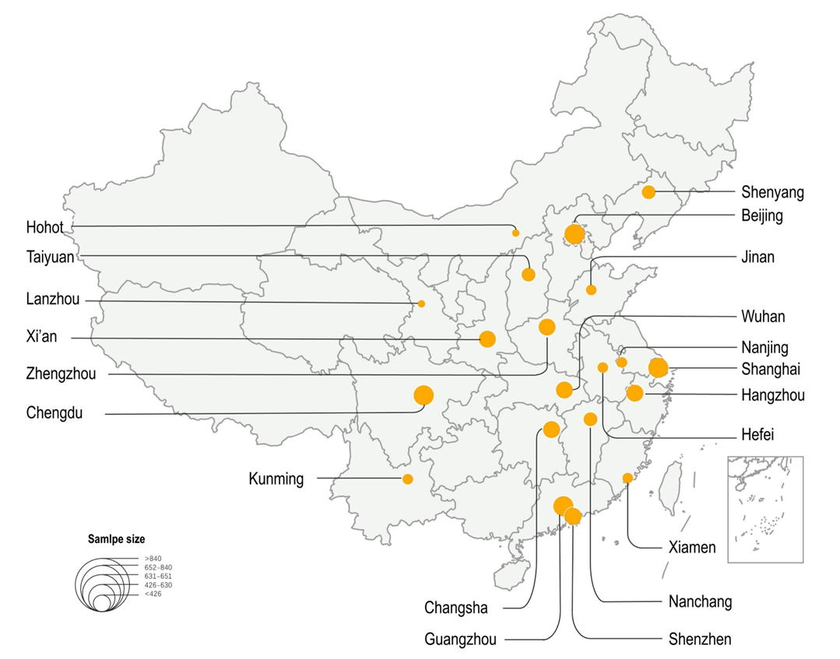
User experience survey in 20 Chinese cities (2022)*: seeking potential needs for Green MaaS
Source: WRI (2022), *Ongoing project, not ready to quote.

Slide 20
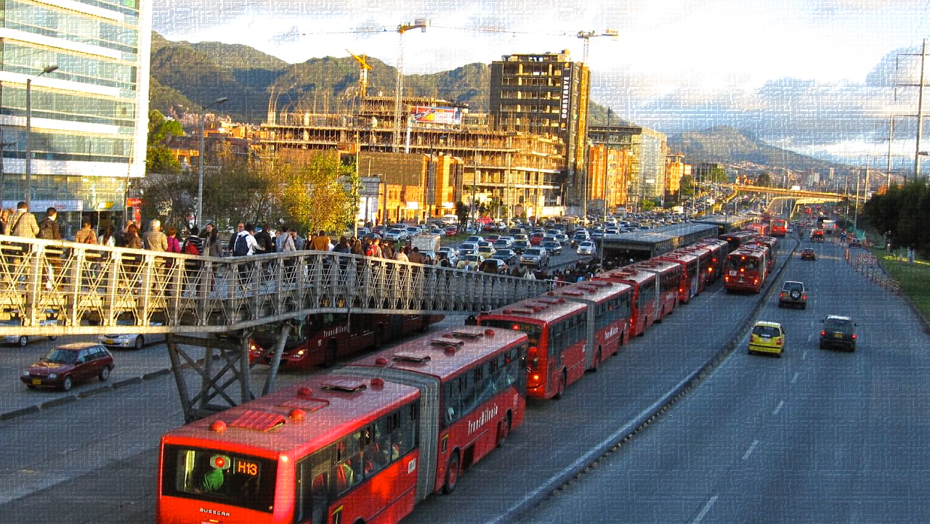
BOGOTA, COLOMBIA

Slide 21
Latin America’s living lab
Informal and shared mobility

Slide 22
The team
Luis A. Guzman
Daniel Oviedo
Olga L. Sarmiento
Next generation scholars (MsC students)
Shared MaaS. Data and technology

Slide 23
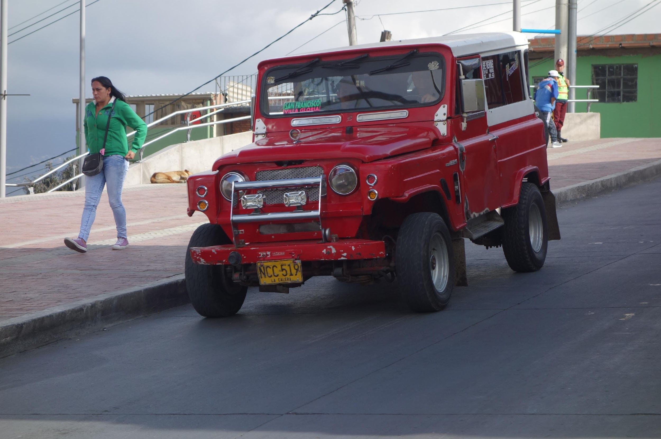
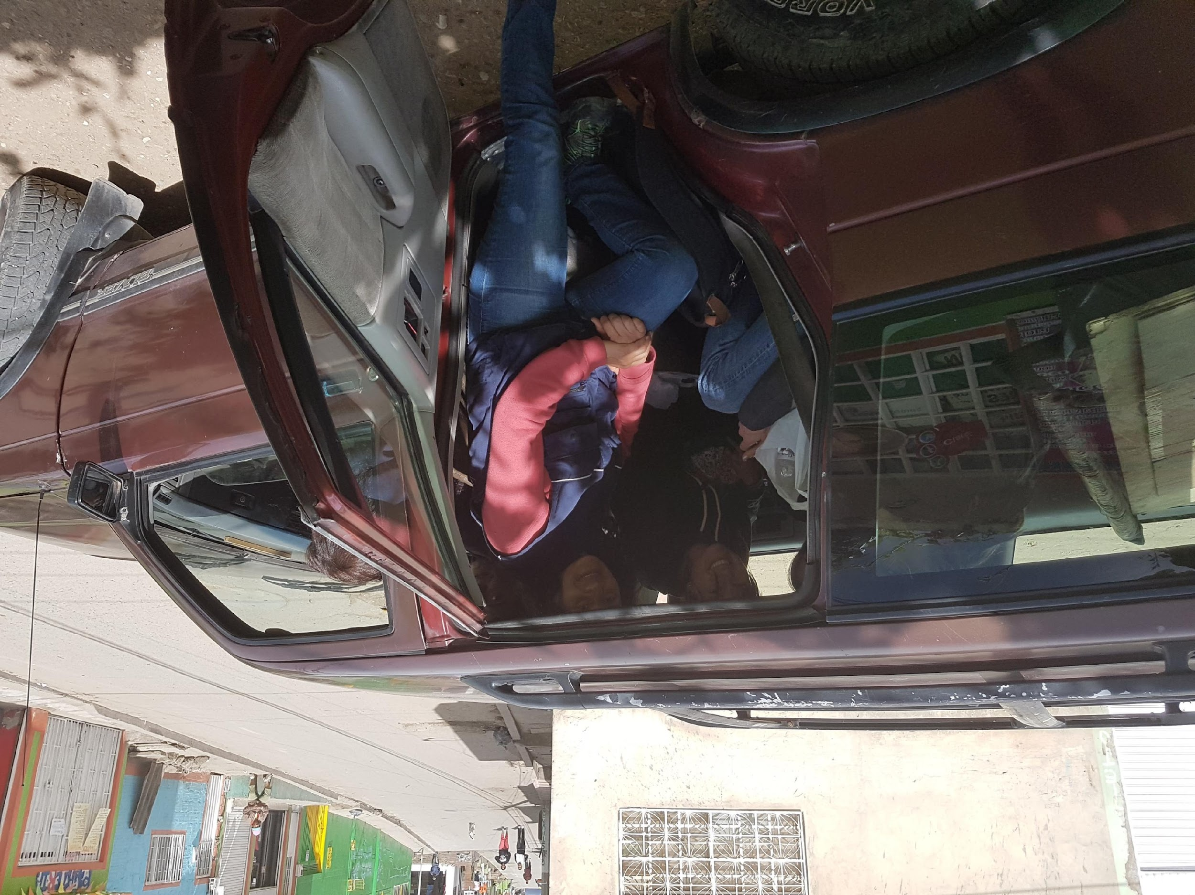
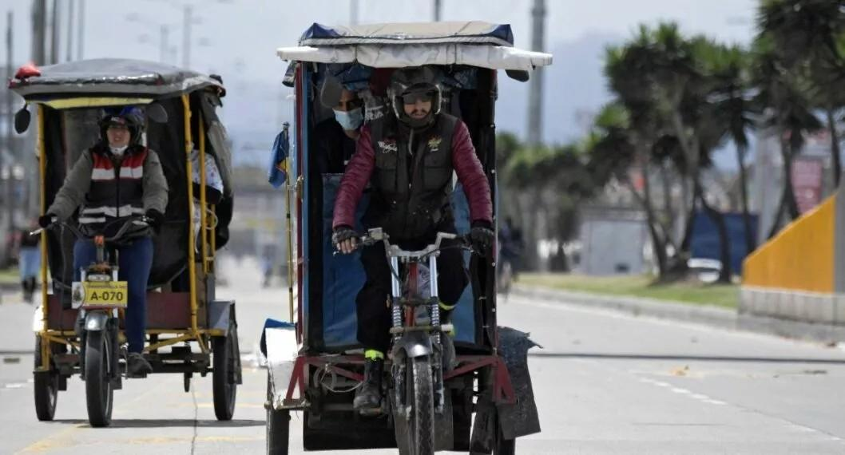
The key problems
Unmet demands
Travel uses and preferences
Affordability, schedules and routes
Security issues and gender gaps
Pulzo.com

Slide 24
Research plan
Initially, we want to conduct two study pilots in two different areas:
Informal transport (old SUVs) in a poor and peripheral area of Bogotá, where it is mainly used for internal trips.
Informal transport (pedicabs -bicitaxis-) is used mainly as a feeder to the formal public transport system (last-mile trips)
Aimed at identifying the general dynamics of the popular transport phenomenon in Bogotá, our living lab framework will include:
Estimate travel demand needs
Know travel patterns
Trip characterization (user type, schedules, origin, destination, stops)
Digitalization of informal trips (channels such as SMS, WhatsApp)
Technology and co-creation as solutions to mobility
Notes:
Describe how you plan to structure your research. Emphasize how the Living Lab framework will be integrated into your approach.

Slide 25
Why is this important?
In Bogotá, as in many Latin American cities, there are larger inequalities in public transport coverage, accessibility and transport affordability.
Informal transport exists to alleviate some of the needs not covered by the formal system.
Why is informal transport still an attractive alternative for people?
How does it work?
Dynamic supply-demand feedback
Notes:
Provide context on how your research addresses broader problems or contributes to the larger field.

Slide 26
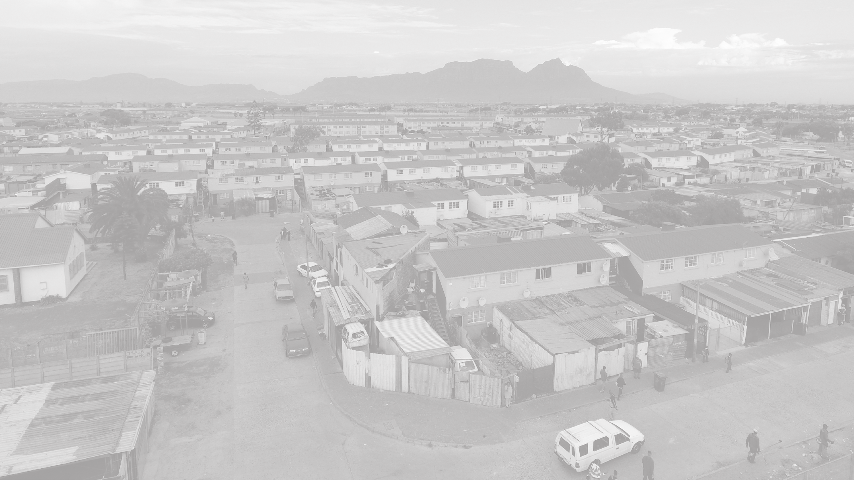
CAPE TOWN, SOUTH AFRICA
Manenberg

Slide 27
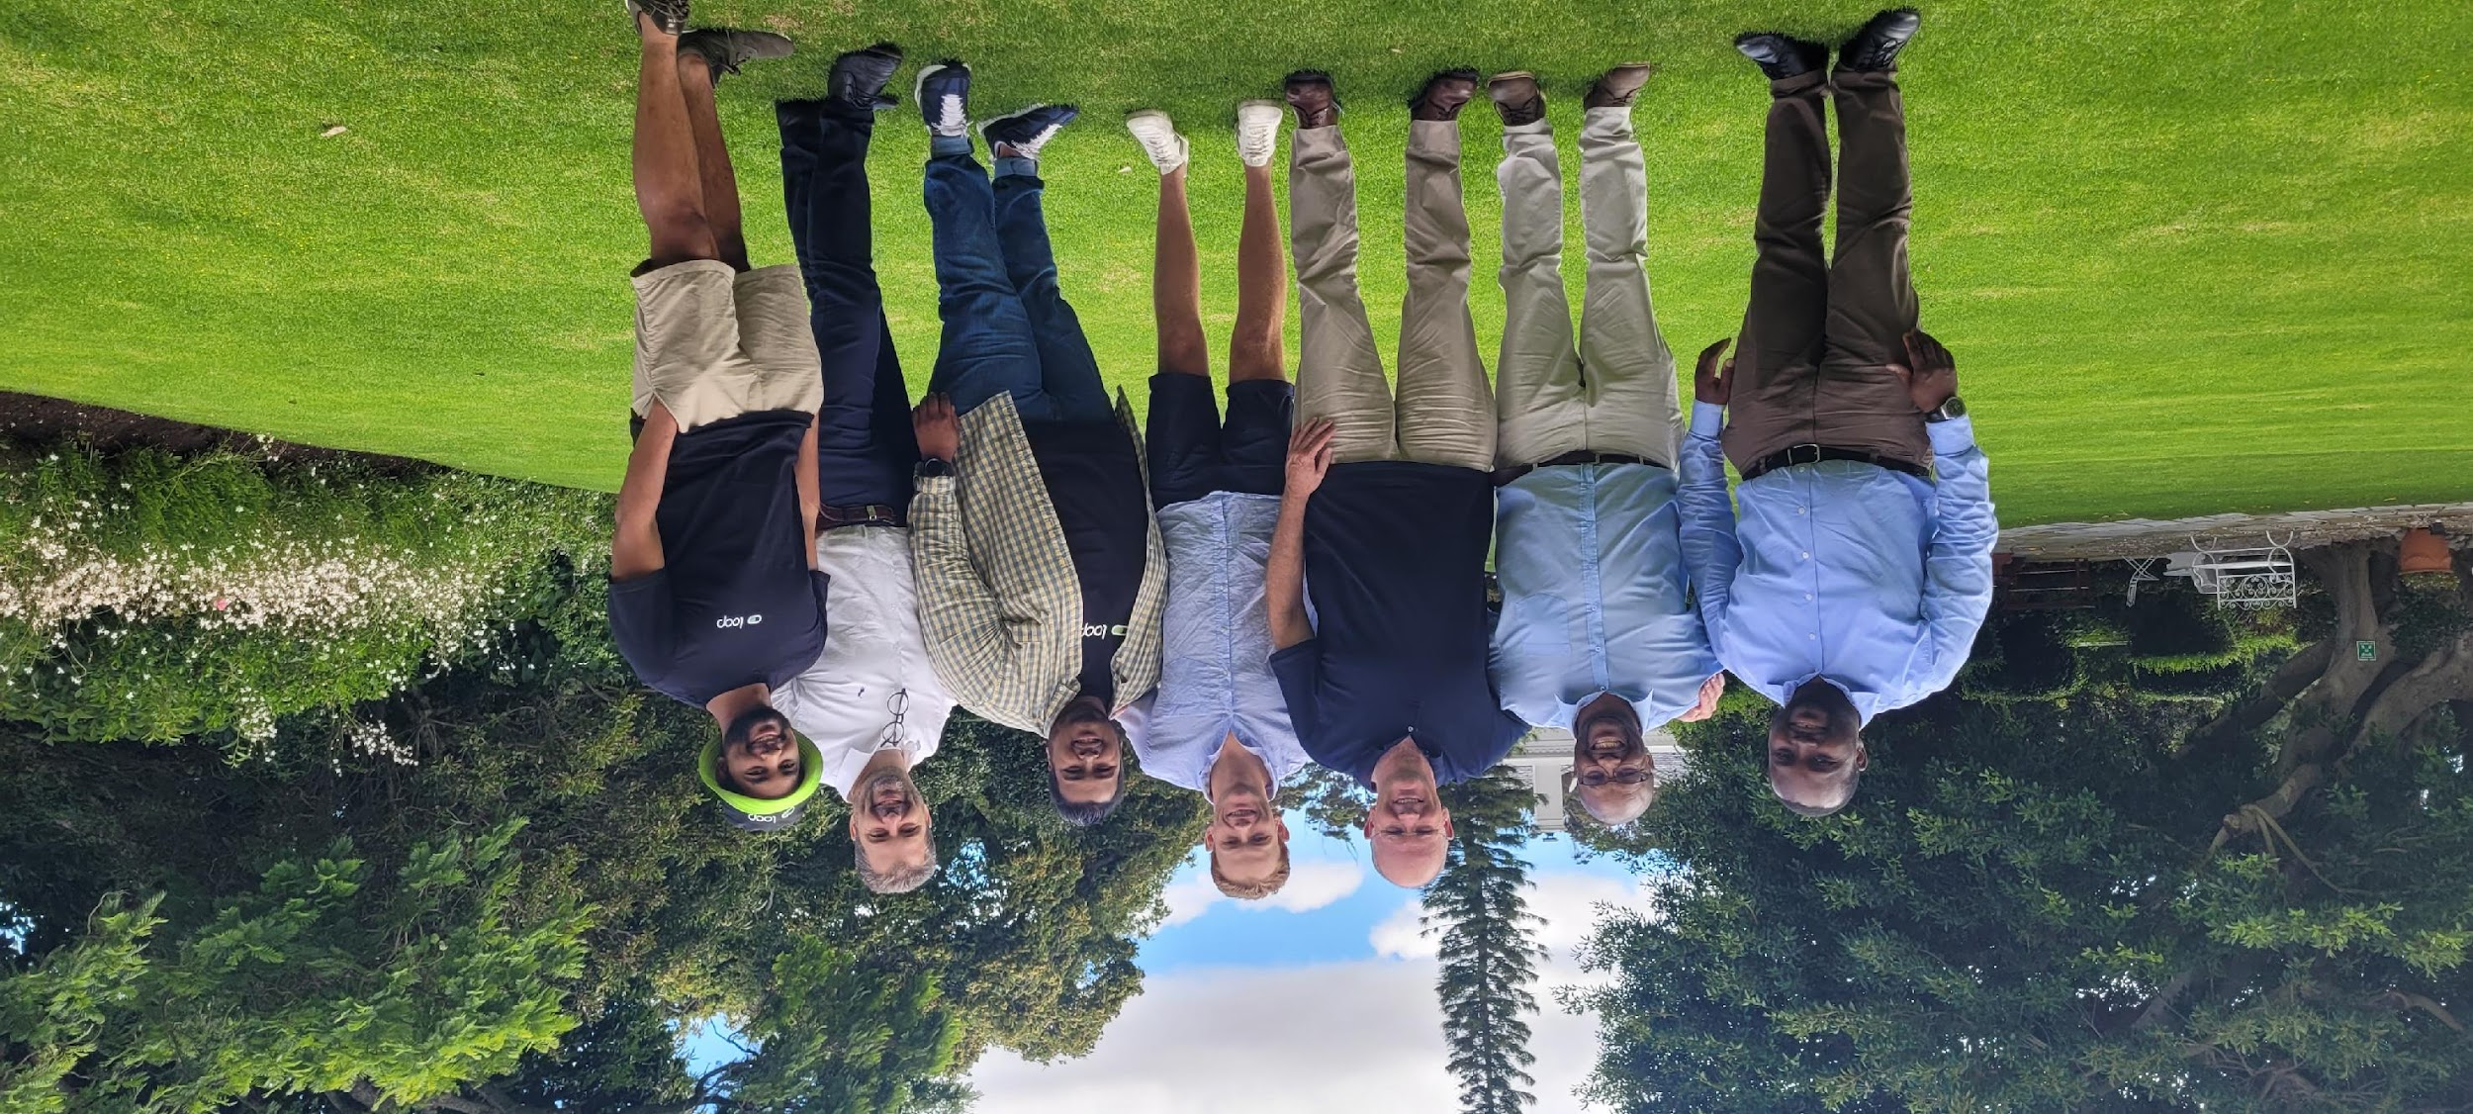
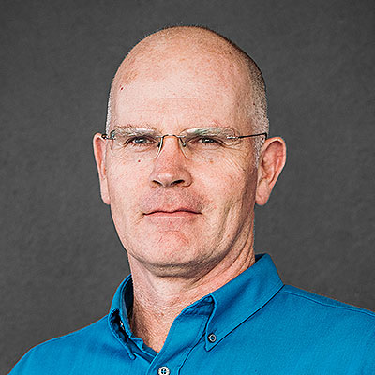
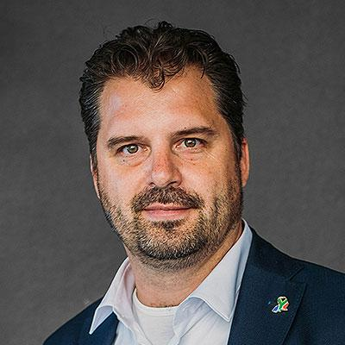
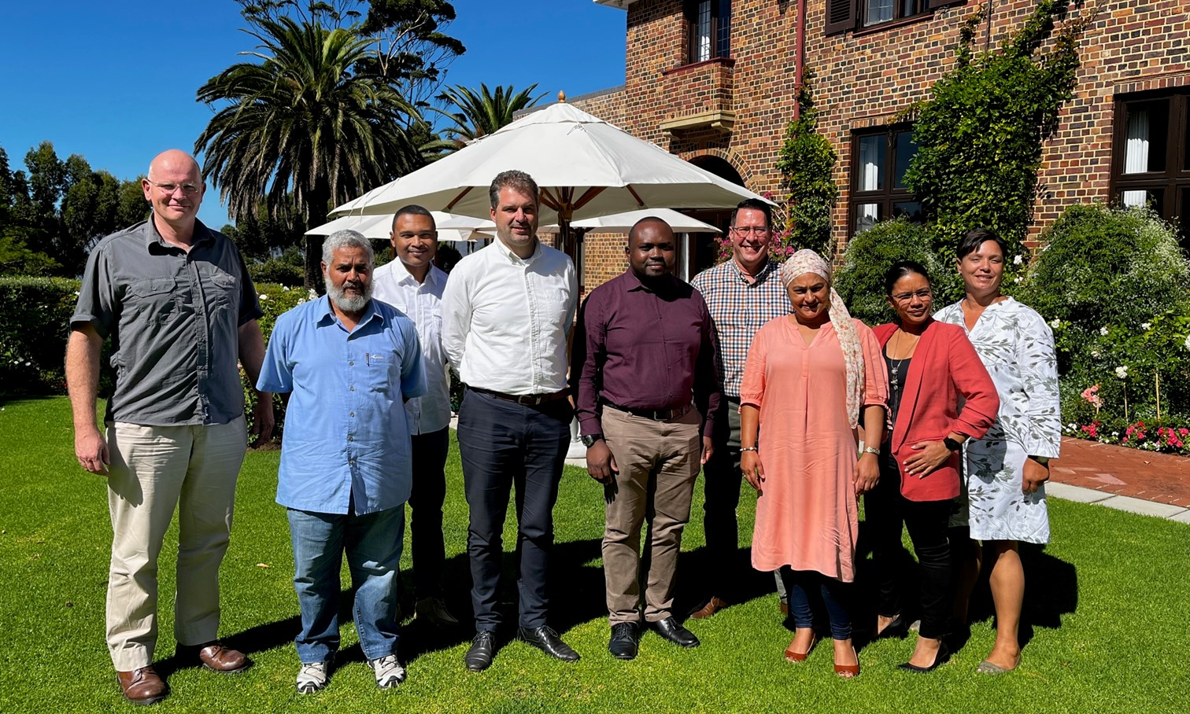
MEMBERS
Academics
Embedded PhD researchers
Partners
Roger BEHRENS
Haniefa GAIBE
Obiora NNENE
An OTHER
Mark ZUIDGEEST

Slide 28
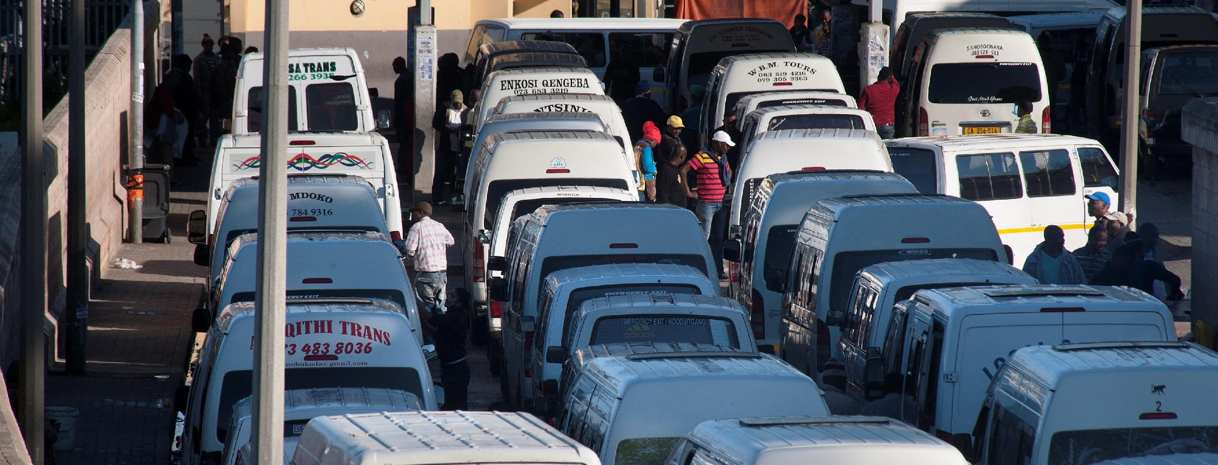
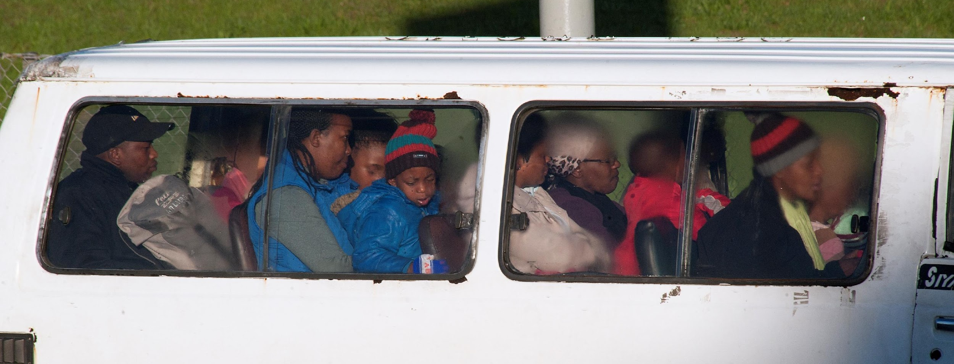
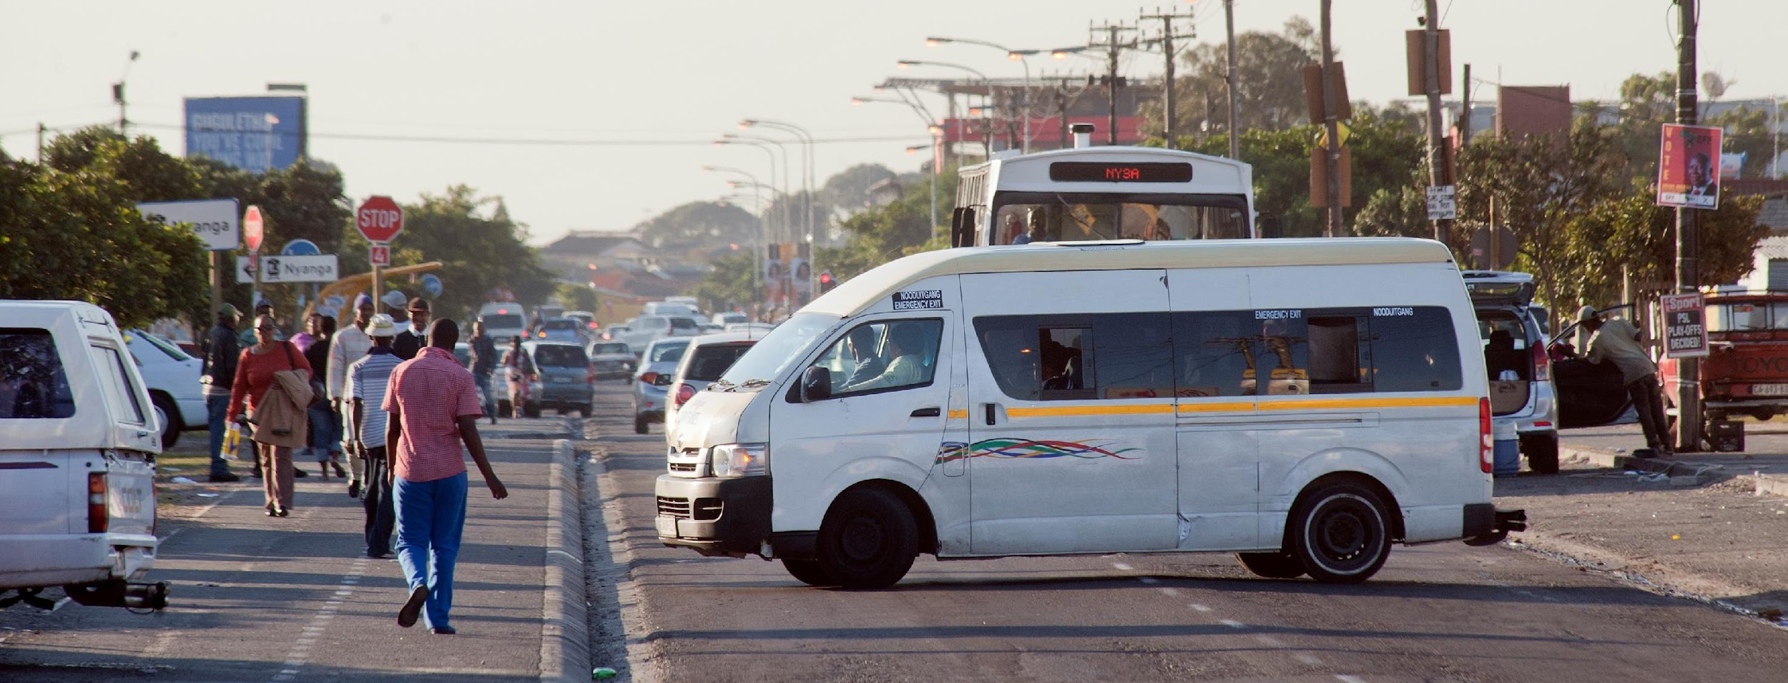
PROBLEMS
fragmented public transport governance
fragmented multi-modal public transport service network
duplicative routes and inefficient operations
poor quality-of-service for passengers
stalled (or abandoned) quality-of-service improvement initiatives
legacy ‘minibus-taxi’ quantity licensing regime, unable to manage market entry or rationalise fleets and route networks

Slide 29
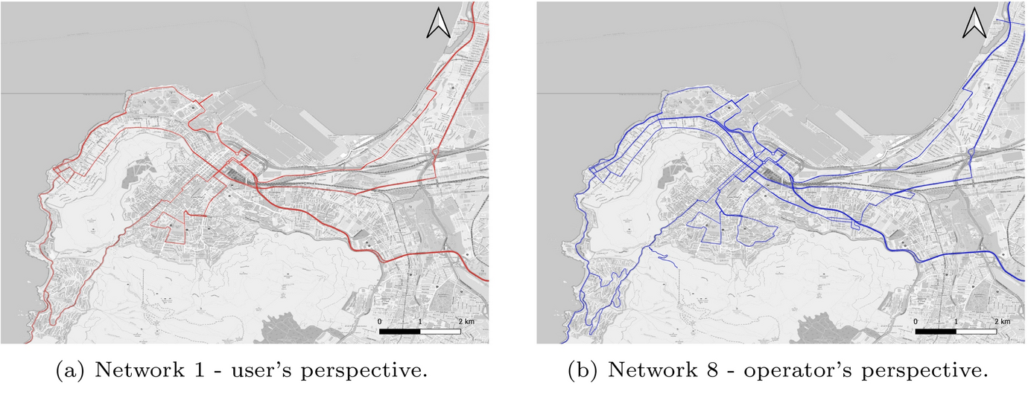
RESEARCH
embedded Loop App research:
purpose: exploring industry reform from an economic development, as opposed to a purely regulatory, perspective
method: ‘living lab’ ground-floor longitudinal monitoring of cashless fare collection and (charter) ride-sourcing technology disruptions for different stakeholders (i.e. association leaders, vehicle owners, drivers, gaatjies, and passengers)
embedded City of Cape Town research:
purpose: exploring proactive operating licensing, linked to devolved operating licensing functions, and the renewal of 7-year operating licenses
method: operator/passenger-cost route and vehicle size optimisation, as an informant of proactive licensing

Slide 30
IMPORTANCE
scalable interventions, aimed at service quality improvement, that operators are willing to accept have proved elusive in Sub-Saharan Africa – industry-led technology disruptions aimed at business development may have better prospects and lessons for elsewhere
(multi-stakeholder) mutually-acceptable cashless fare collection and ride-sourcing technologies (applicable in target-, commission- and salary-remuneration business models) have struggled to endure in Sub-Saharan Africa minibus operations – a technology that does not force an immediate disruption of the target system, and does not generate greater exposure to income tax, may have better prospects and lessons for elsewhere
existing legislation and regulatory approaches have contributed to operating inefficiencies – there may be considerable potential for rationalising vehicle size and service route alignments (and over- and under-trading problems across the city public transport service network) that can inform a more proactive (multi-modal) approach to operating licensing

Slide 31
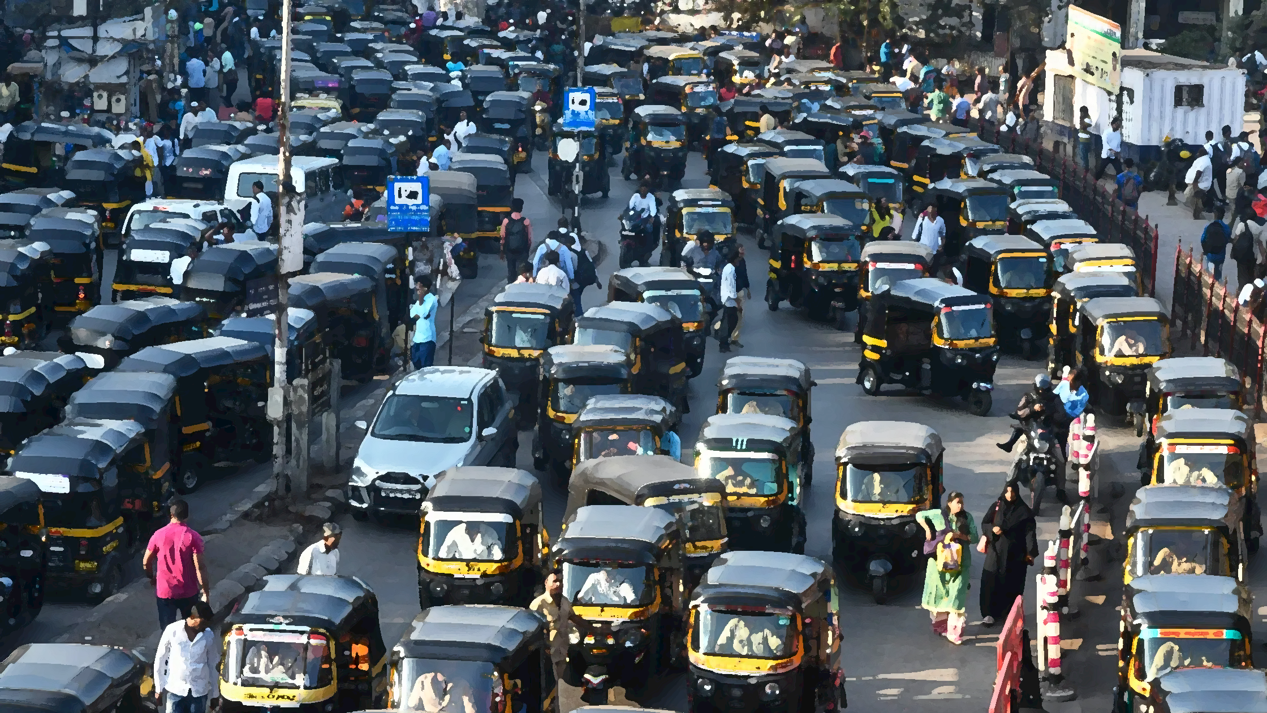
MUMBAI, INDIA

Slide 32
MUMBAI
Living Lab

Slide 33
Team Ecosystem
COMMUNITY
ORGNISATION
Youth for Unity and Voluntary Action(YUVA)
NGO
Velaipada Samaj
Neighbourhood Collective
Kamgaar Union
Auto Union
Aneerudha Paul
Principal
investigator
Sheela Patel SPARC
Maria Lobo
SPARC
Alex Mohan
Co-PI
Kshitija Akre
Research
Associate
ACADEMIC
ORGANSIATION
Kamla Raheja Vidyanidhi Institute for Architecture (KRVIA)
Academic Institute

Slide 34
Key Problems
OPERATORS / DRIVERS
Provision of public infrastructure
Operational inefficiencies
Maintenance checks and facilities
Access to health and educational benefits
PROVIDER
LIVELIHOOD
ACTING AS
INFORMAL SHARED MOBILITY
ENABLER
USERS
User comfort and convenience
User safety concerns
Poor connectivity to low-income neighbourhoods
Fluctuating fare prices
Insufficient Infrastructure to access public transport

Slide 35
Framework
Kamgaar Union
Auto Union
Political Organisations
Nalasopara,
MMR
Participation for Route Mapping using GTFS
(Operator study)
Urban Research Fellowship
Masters Thesis Programme
Embedded with the program
Velaipada Samaj
Neighbourhood Collective
Participation for Activity Based Modelling
(User study)
Living Lab
Designing and Developing the Methods for study
Activity Based Modelling
(User study)
Route Mapping using GTFS
(Operator study)
Urban Local Bodies
Youth for Unity and Voluntary Action(YUVA)
NGO

Slide 36
Why it Matters
ROUTE RATIONALIZATION
Last mile connectivity
Accessibility with other public transport
ENCOURAGE GREEN MOBILITY
Green mobility provider/Vendor
DOWNSTREAM LIVELIHOODS
Maintenance shops
Repair and parts shops
RECOGNITION AS PUBLIC TRANSPORT
IMPROVE COMMUNITY
RESILIENCE
Health benefits, Insurance Benefits
Education loans
NEGOTIATE BETTER PUBLIC INFRASTRUCTURE
Parking Structures, Charging Points, Water Drinking points, Resting points
ACCESS TO EASY LOANS
Access to subsidized Government Bank loans

Slide 37
SAN JOSE, COSTA RICA

Slide 38
An Equity, Ecosystems and Engaged Approach to Informal Transport and Shared Mobility
LL San José, Costa Rica
December, 2023

Slide 39
Members of our Living Lab team
Arturo Steinvorth
Josephine Dusapin
Karla Gutiérrez
Elena Campos
Carla Quesada
Partners (Academy):
*In conversations

Slide 40
Key problems in research
No baseline information about popular transport services.
Authorities see popular transport as an issue, rather than an opportunity but can't act because there is no information.
Authorized public transport services see popular transport as a threat, rather than an opportunity to complement their operations.
Current operations of popular transport have no requirements, leaving both operators and users exposed to more risks.
Why our research is important?
Identify how popular transport provides access to people in low-income and vulnerable communities.
Provide technical support to decision makers about how to take advantage of current transport services to improve access to opportunities in low-income and vulnerable communities.
Engage with transport stakeholders to integrate popular transport services into the transport system.
Provide understanding on the importance and opportunity of popular transport services within the transport system.

Slide 41
2024 Activities and methodology
Desk research
Field research
Popular transport worldwide, in LAC and in CR.
Popular transport in low income communities.
Legal framework regarding public transport and popular transport.
Land use and Public Transport routes around the communities served by popular transportation in the area.
Vehicles identified and seized by police authorities
General demographics, migrations and the community
Observations of how and where the services operate.
Engagement with operators and users, city government, community and Public Transport authorities
Service usage information (users' perceptions, integration with PT, routes and services, demographics including migrations, social exclusion, types of trips, etc).
Interviews with counterparts: community leaders, public transport providers, businesses, authorities, municipal police and other local officers, NGOs.
Workshops
Synthesis of information
With authorities, operators, users, community to define basic information and research questions

Slide 42
Reflections and the role of networks in transformation
Andrea San Gil León
Global Network for Popular Transportation

Slide 43
Even though popular transportation is a truly global phenomena, it is usually seen and treated as a local problem
The image of an ideal public transportation system is very much dominated by western, European or North American models
Anything that strays from those models tends to be considered inferior, bad, and should be substituted by these ideal models

Slide 44
How much do we really understand about these systems?
How can we reimagine the transformation and improvement of our public transportation systems in the Global South in a way that recognizes the value, contribution and importance of existing assets, services and infrastructure and that leaves no one behind?

Slide 45
Learning and innovation
Faster information dissemination
Exchange of ideas, knowledge and experiences
Mobilizing resources
Increased scope and impact
Wider net of contacts and potential allies
Why is a network important?
Increasing collaboration
Connect people with different knowledge, resources and skills
Maximize resources
Advocating for change
Representing a diversity of contexts
Amplifying voices
Power in numbers

Slide 46
Internal meetings and sensemaking board: to learn from each other and document these learnings
Monthly Newsletter: to share our progress and learnings to the wider public
“Meet and Greets”: doing deep dives with the living labs and sharing learnings with the general public and popular transport community
Global Conferences: taking learnings from local to global, raising awareness and leveraging support for popular transportation

Slide 47
Thank you very much
andrea@sharedusemobilitycenter.org
www.populartransport.net
poptransport.substack.com

Slide 48
ALL CONTACTS
ACCRA & KUMASI
Ransford A. Acheampong
ransfordantwi.acheampong@manchester.ac.uk
BANGKOK
Saksith “Tan” Chalermpong
saksith.c@chula.ac.th
BEIJING
Su Song
ssong@wri.org
BOGOTA
Luis A. Guzman
la.guzman@uniandes.edu.co
CAPE TOWN
Roger Behrens
roger.behrens@uct.ac.za
MUMBAI
Aneerudha Paul
anirudh.paul@gmail.com
SAN JOSE
Arturo Steinvorth Álvarez
arturo@cpsurbana.org
Keep in touch with us!
Scan for more contact details

