Slide 1
Predictors of distractive activities to walking in Accra, Ghana
Odame, Sam and Amoah-Nuamah
VREF MAC NextGen Scholars

Slide 2
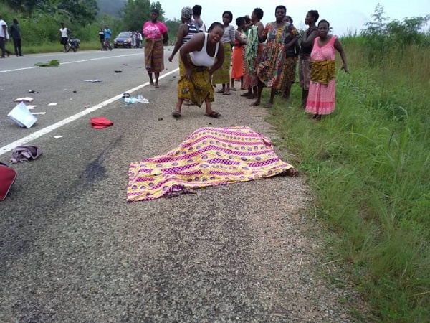
Introduction
Walking is a fundamental mode of transport
Immense health and environmental benefits
Increased walking = increased risk of road traffic crashes
Notes:
car-oriented societies where traffic enforcement is poor, and pedestrians' needs are neglected mainly in roadway design and land-use planning

Slide 3
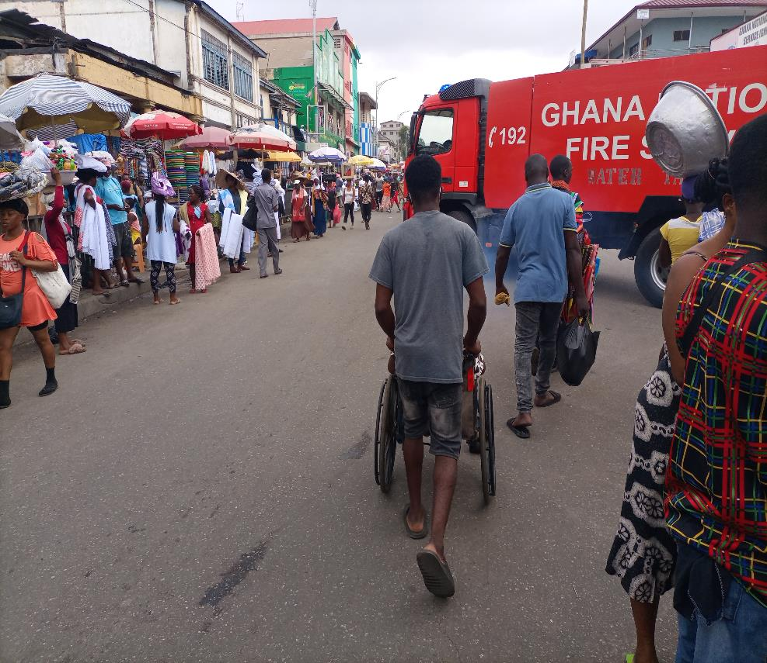
Introduction Cont’d
2 out 5 killed are neither travelling in a car or on a motorcycle
Disaggregations presents a much darker image for Africa
22% (US), 27% (Europe) and Africa (40%) of pedestrians casualties (WHO, 2018)
In Ghana, 38.9% of pedestrians are annually involved in road traffic crashes (BRRI, 2020).
Notes:
the 1.35 million people

Slide 4
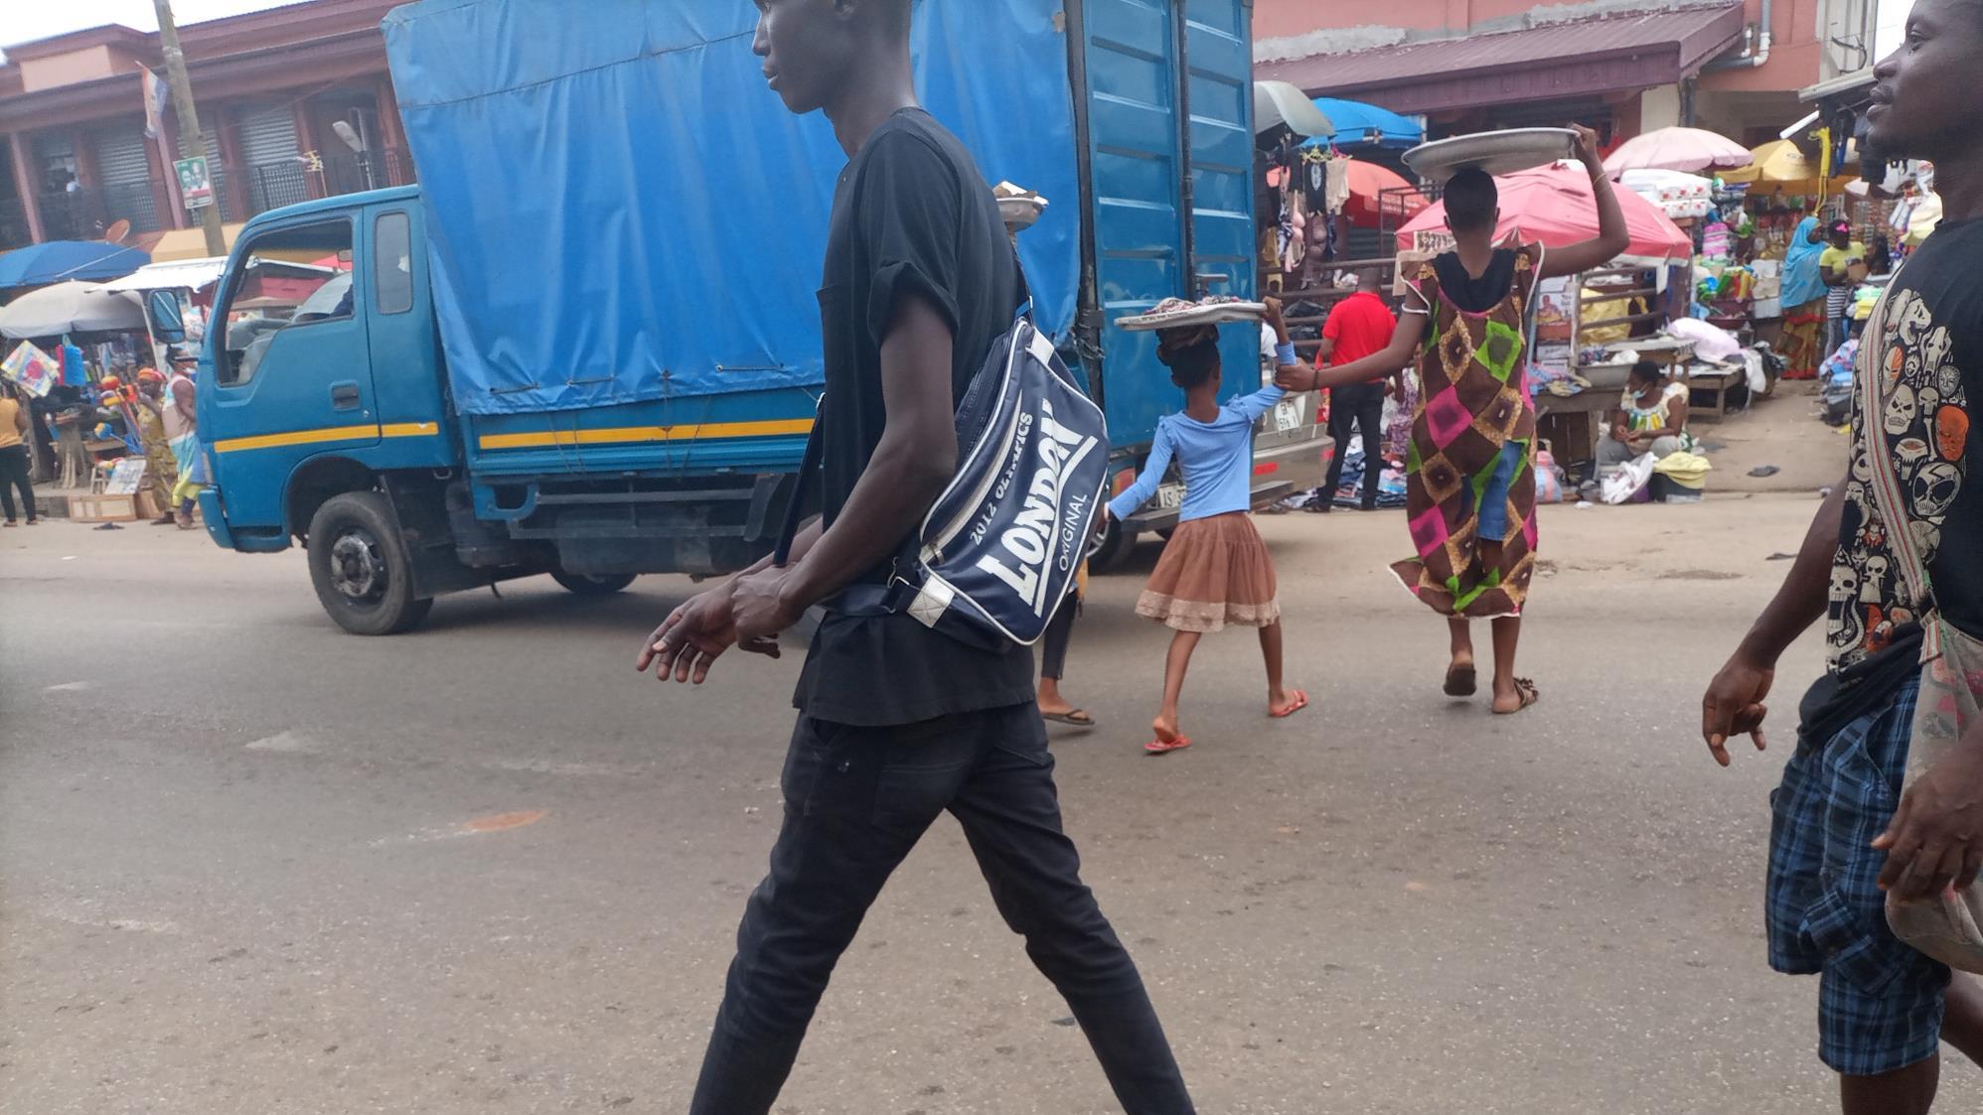
Introduction Cont’d
Not all about the presence of sidewalks or traffic enforcement
Risky in-traffic walking behaviour heightens pedestrian's risk of injuries.
Plethora of evidence exists on driver distraction leaving behind a dread of evidence of pedestrian distraction (WHO, (2011:2013), Elvik et al. (2009), Jacobsen (2003))
This study offers important insights into distractive walking in an urban environment and policy-relevant interventions for targeting distracted walking.
Notes:
Pedestrians' vulnerabilities are evident through a combination of key risk factors
Even if sidewalks are present, Useche et al. (2020) report that risky in-traffic walking behaviour such as the consumption of alcohol, chatting with others, and the use of a mobile phone also exponentially heightens pedestrian's risk of injuries in major cities like Accra, Lagos, Nairobi and Banjul

Slide 5
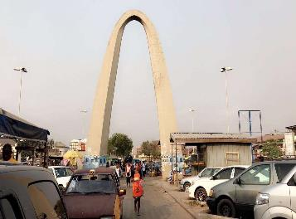
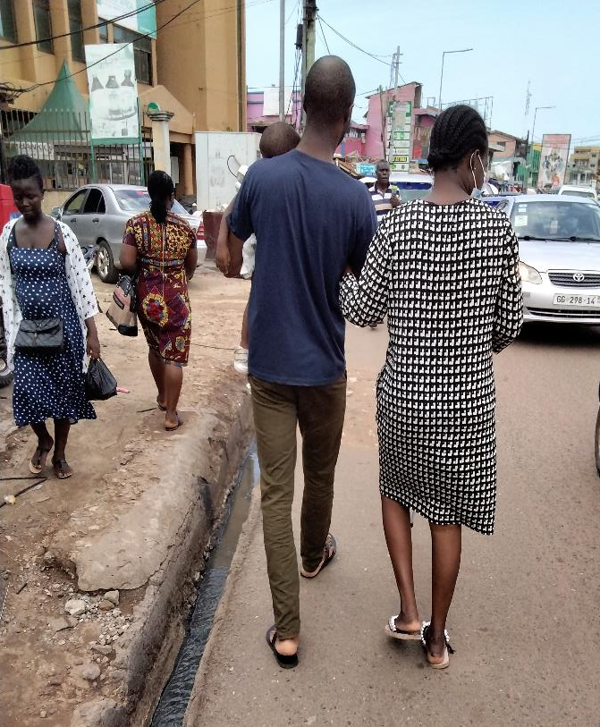
Method and Setting
The study setting was in CBD (Accra)
57.6% of the Greater Accra’s pedestrian injuries
A top 5 crash-prone city in Ghana
Pedestrians above 16 years
Using Miller & Brewer's (2003), 400 people were engaged for the study
Conveniently sampled from shopping malls
Melcom plaza
Rawlings park
Despite stores
SIC Mall.
Lava Mall
Questionnaire was deployed via Kobo Toolbox
Notes:
are the most susceptible to traffic injuries in Ghana (Building and Road Research Institute, 2020).

Slide 6
Setting and Method
The questionnaire had three sections
Socio-demographic characteristics
Ranking of distractive walking activities
The extent of engagement in distractive activities to walking
SPSS and Jamovi
The Binary logistic regression model (11 independent variables: age, sex, marital status, religion, level of education and occupation)
The output was presented as Odds Ratio (O.R.) using a 95% Confidence Interval (CI).

Slide 7
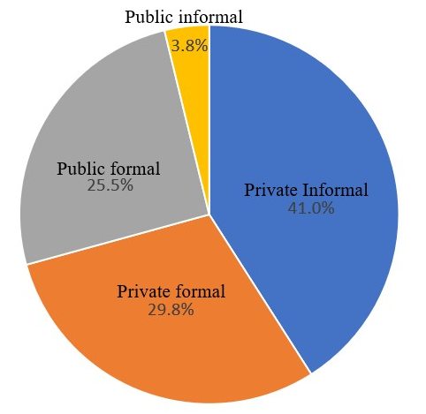
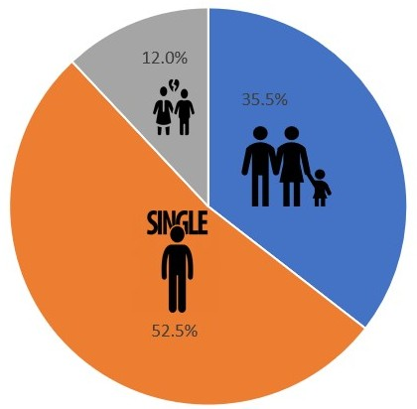
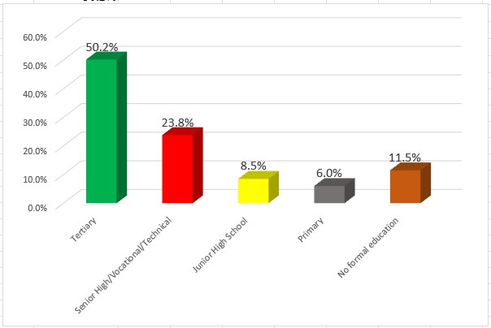
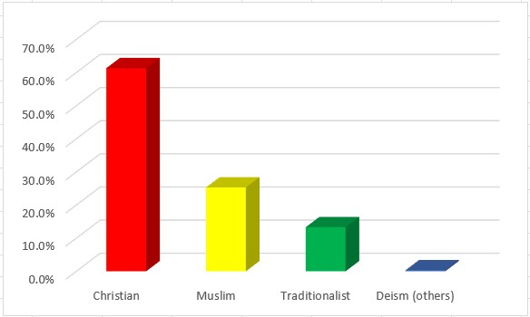
Profile of respondents

Slide 8
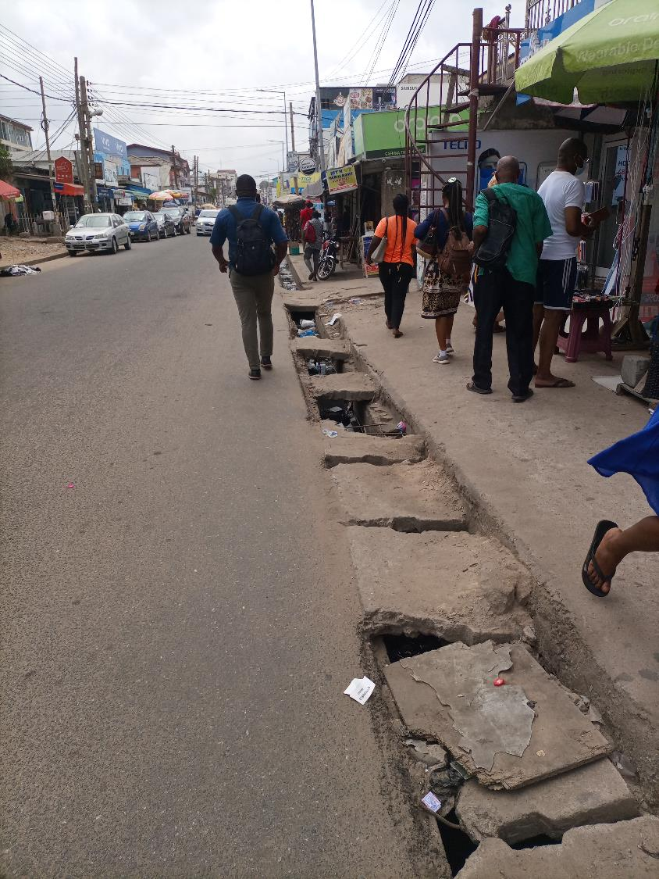
Ranking of distractive activities to walking
3 of the Top 4 entails digital technology
Last 3 items projects seldomly engaged activities

Slide 9
Binary logistic regression analysis on pedestrians’ engagement in distractive activities to walking
Variable | p | Odds ratio | 95% Confidence Interval
 |  |  | Lower Limit | Upper Limit
Gender:
Female | Ref
Male | 0.016 * | 2.20 | 1.16135 | 4.1818
Age category
16-26 years | Ref
27-37 years | < .001 ** | 12.30 | 3.09036 | 48.9638
38-48 years | 0.582 | 1.29 | 0.52099 | 3.1933
49-59 years | 0.390 | 0.66 | 0.25836 | 1.6955
60 or more years | 0.604 | 0.39 | 0.01104 | 13.7212
Religion
Christian | Ref
Muslim | 0.957 | 0.98 | 0.47873 | 2.0077
Traditionalist | 0.412 | 1.53 | 0.55544 | 4.2002
Others | 0.989 | 0.00 | 0.00000 | Inf
Marital status
Married | Ref
Single | 0.275 | 1.56 | 0.70293 | 3.4525
Divorced | 0.168 | 2.11 | 0.73132 | 6.0608
Cronbach alpha (α) = 0.737
Module summary
The overall model was statistically significant, χ2 (26, N=400)=218, p < .001
11 independent variables (sex, age, marital status, religion, level of education, occupation, residence, disability, reasons for walking, weekly time spent walking and walking time for common trips).
Notes:
The larger Cox & Snell estimate is the better the model; but it can be greater than 1
The Nagelkerke estimate is calculated in such a way as to be constrained between 0 and 1. So, it can be evaluated as indicating model fit; with a better model displaying a value closer to 1
The Cox & Snell R Square and the Nagelkerke R Square values provide an indication of the amount of variation in the dependent variable explained by the model (from a minimum value of 0 to a maximum of approximately 1).
48- chi square value

Slide 10
Variable | p | Odds ratio | 95% Confidence Interval
 |  |  | Lower Limit | Upper Limit
Education
No formal education | Ref
Primary | 0.248 | 0.41 | 0.08949 | 1.8649
Junior High School | 0.201 | 2.65 | 0.59425 | 11.8465
Senior High School | 0.044* | 4.56 | 1.04373 | 19.9062
Tertiary | 0.700 | 1.28 | 0.37090 | 4.3830
Occupation
Private Informal | Ref
Private formal | 0.590 | 0.62 | 0.11037 | 3.5025
Public informal | < .001** | 13.29 | 16.59522 | 1064.3168
Public formal | < .001** | 0.00 | 1.87e-4 | 0.0664
Residence
Rural area | Ref
Urban area | 0.900 | 1.05 | 0.52132 | 2.0982
Observed Disability
No | Ref
Yes | 0.708 | 1.43 | 0.22103 | 9.2263
Reasons for walking
Daily commuting | Ref
Short trip to a specific point in the city | 0.966 | 0.97 | 0.24919 | 3.7801
As a part of job routine | <0.001** | 13.54 | 2.93342 | 62.4720
Notes:
The larger Cox & Snell estimate is the better the model; but it can be greater than 1
The Nagelkerke estimate is calculated in such a way as to be constrained between 0 and 1. So, it can be evaluated as indicating model fit; with a better model displaying a value closer to 1
The Cox & Snell R Square and the Nagelkerke R Square values provide an indication of the amount of variation in the dependent variable explained by the model (from a minimum value of 0 to a maximum of approximately 1).
48- chi square value

Slide 11
Variable | p | Odds ratio | 95% Confidence Interval
 |  |  | Lower Limit | Upper Limit
Time spent walking (Weekly)
1-5 hours | Ref
6-10 hours | < .001** | 0.01 | 0.00153 | 0.0506
11-15 hours | 0.087 | 0.22 | 0.03924 | 1.2445
Walking time for common trips
0-15 minutes | Ref
16-30 minutes | < .001** | 7.04 | 17.16630 | 288.4098
31-45 minutes | < .001** | 4.22 | 68.05334 | 3139.0748
46-60 minutes | < .001** | 3.05 | 944.17851 | 469464.8719
Notes:
The larger Cox & Snell estimate is the better the model; but it can be greater than 1
The Nagelkerke estimate is calculated in such a way as to be constrained between 0 and 1. So, it can be evaluated as indicating model fit; with a better model displaying a value closer to 1
The Cox & Snell R Square and the Nagelkerke R Square values provide an indication of the amount of variation in the dependent variable explained by the model (from a minimum value of 0 to a maximum of approximately 1).
48- chi square value

Slide 12
Conclusion
The study has shown that sex, age, level of education, occupation, reasons for walking and weekly time spent walking influence pedestrians’ engagement in distractive walking activities
Respondents who identified as males, young adults, with lower educational attainment, informal workers and those with more walking time were more likely to engage in distractive activities to walking.
Environmental planning scheme that minimises distractions to pedestrians.
The NRSC and AMA should intensify public outreach programmes for safer pedestrians outcome.
Additionally, city authorities can also reduce pedestrian distractions by controlling the use of sidewalks for economic activities
Notes:
The educational programmes may use radio and T.V. programmes that seek to change pedestrians' behaviour from listening to music or using mobile phones to a full appreciation or concentration of the road environment.

Slide 13
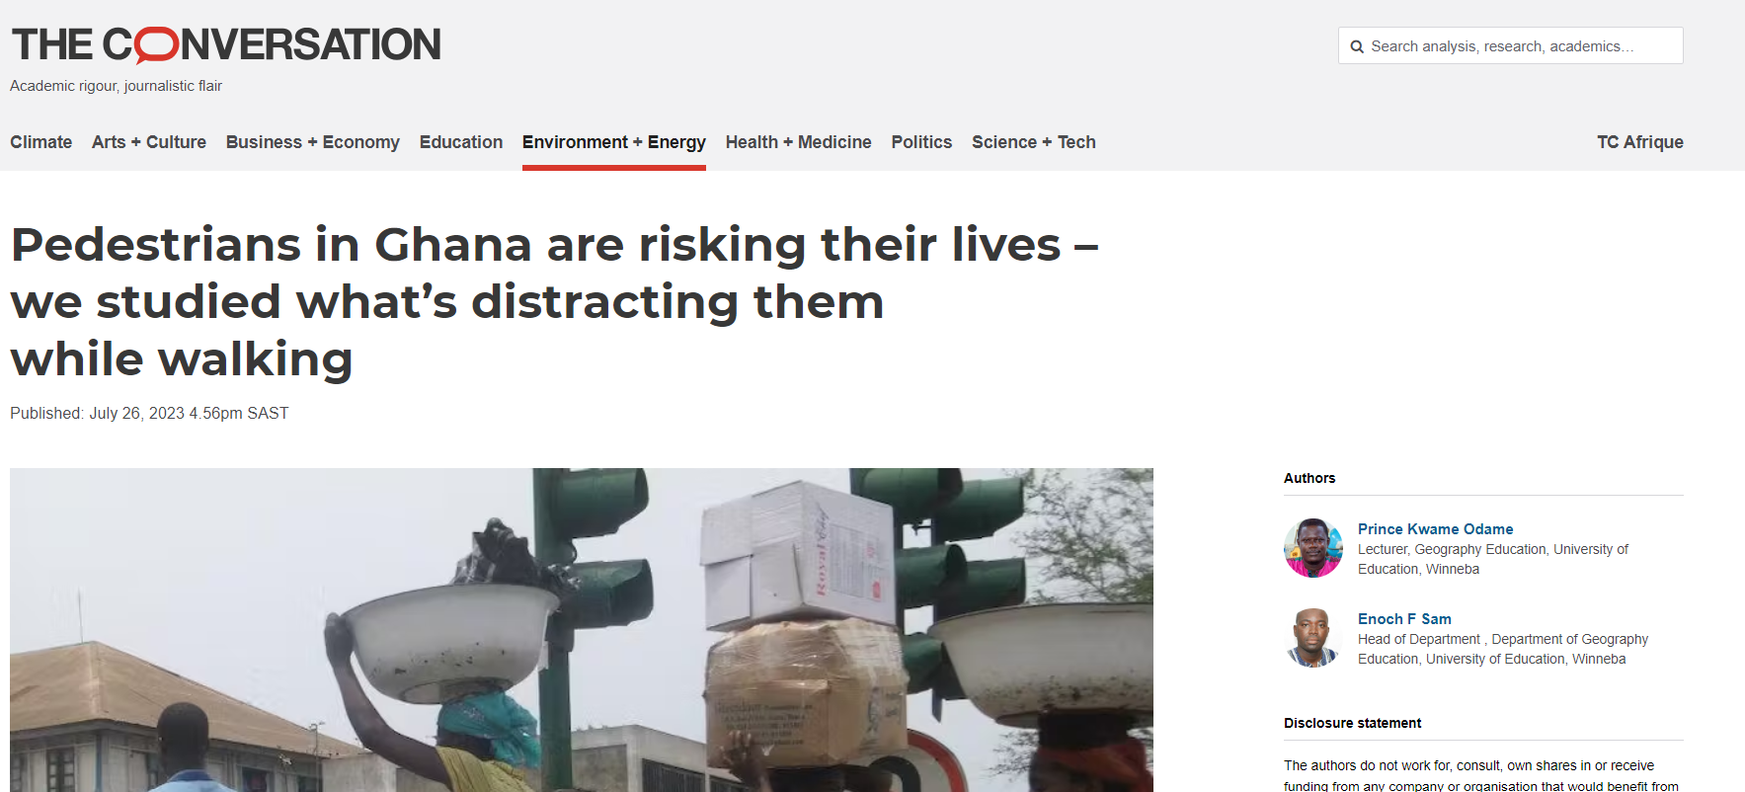
Notes:
The educational programmes may use radio and T.V. programmes that seek to change pedestrians' behaviour from listening to music or using mobile phones to a full appreciation or concentration of the road environment.

Slide 14
Thank you

