Slide 1
Urban roads Enablers or Barriers to Walking? Chebe Polycap PhD candidate, Technion - Israel Institute of Technology

Slide 2
Project team members
Prof. Karel Martens – Technion - Israel Institute of Technology, Israel
Prof. Lawrence Fombe – University of Bamenda, Cameroon
Prof. Mark Zuidgeest – University of Cape Town, South Africa
Dr. Alphonse Nkurunziza – University of Rwanda, Rwanda
Chebe Polycap, PhD student – Technion - Israel Institute of Technology, Israel

Slide 3
Introduction
Notes:
Journey of my life

Slide 4
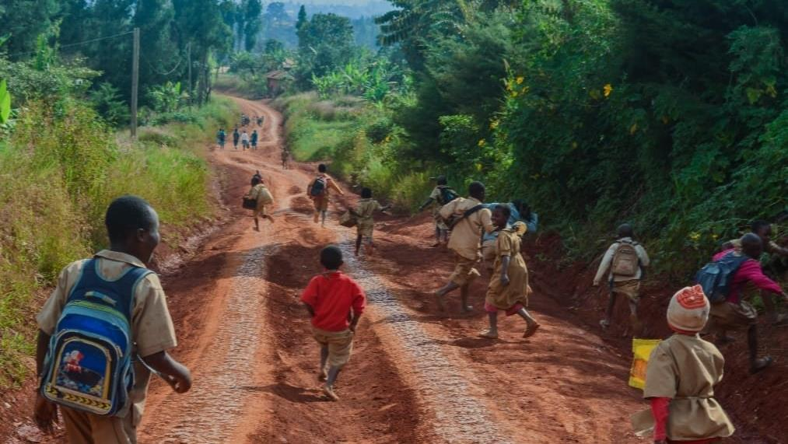
My daily journey as a young primary school kid in Bafut, Cameroon

Slide 5
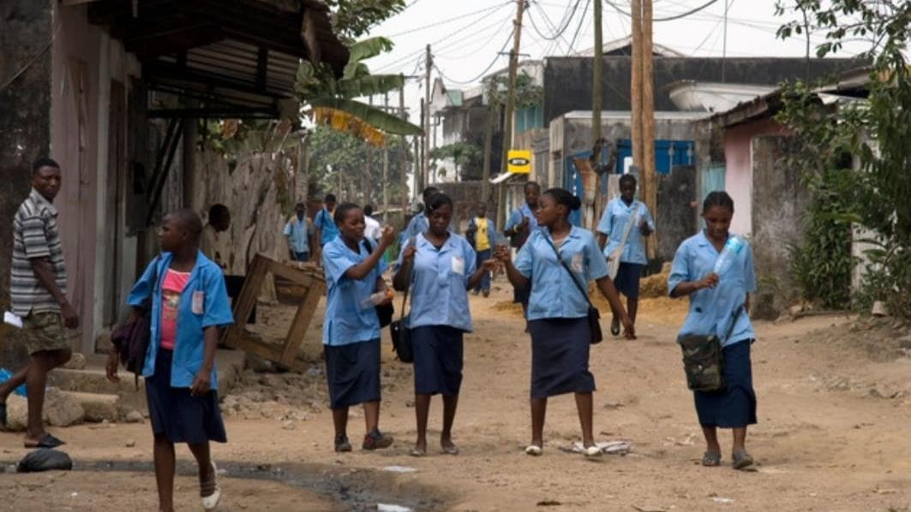
My secondary school days as an adolescent

Slide 6
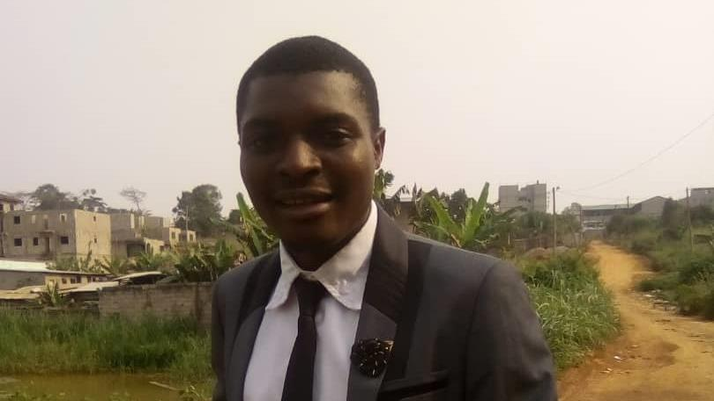
My daily journey as an adult

Slide 7
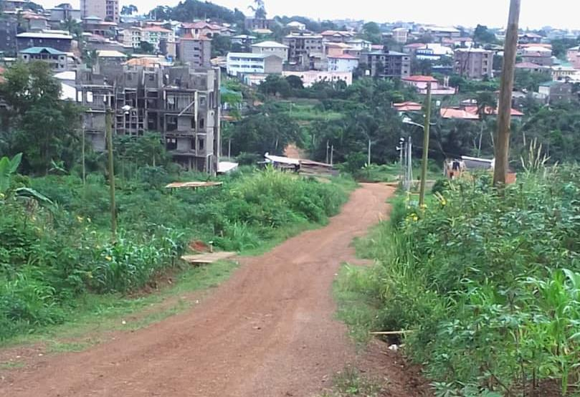
Daily road to/from house

Slide 8
The project

Slide 9
Urban roads Enablers or Barriers to Walking? A research project within the VREF PROGRAMME “Walking as a mode of transport”

Slide 10
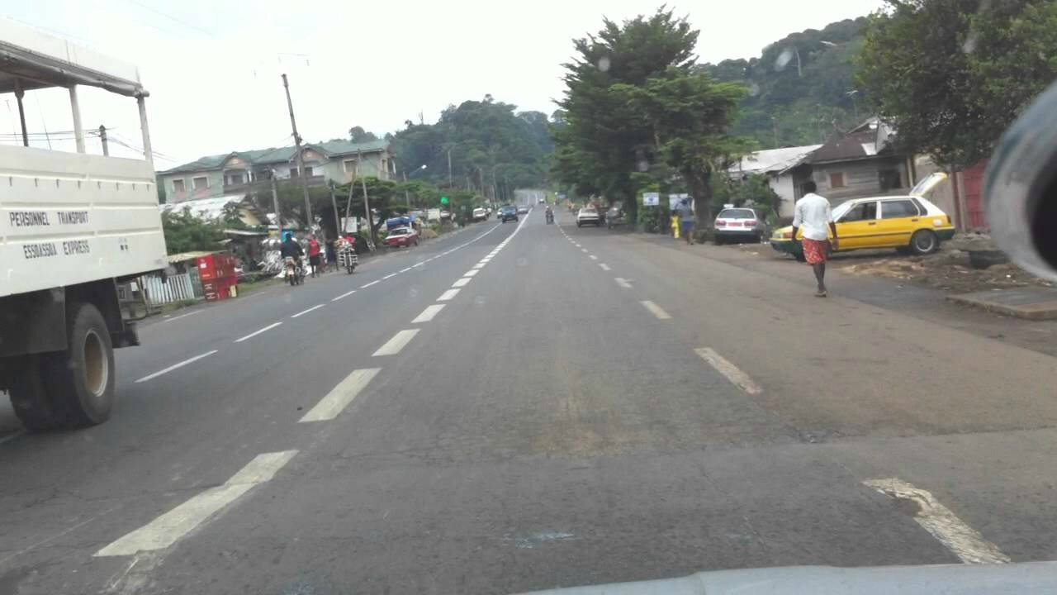
What types of roads do we design for our urban areas
Notes:
Take a look at these image

Slide 11
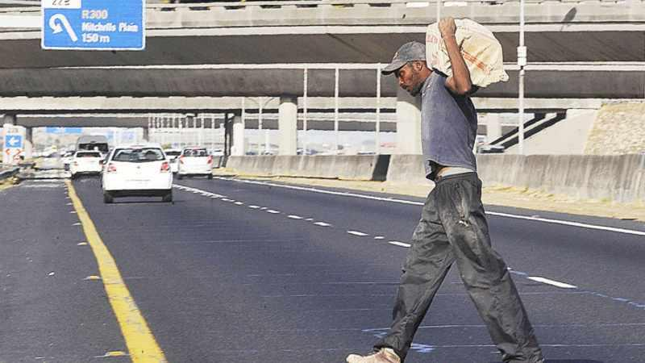
Notes:
Take a look at these image

Slide 12
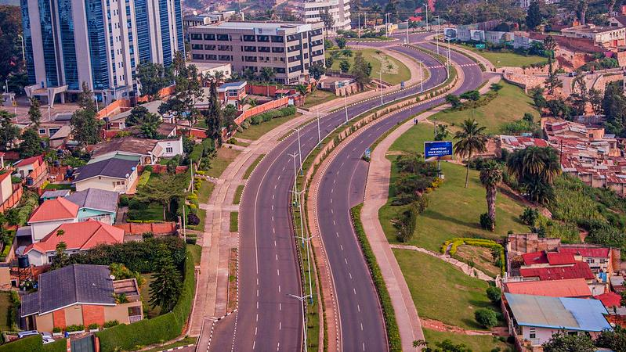
Notes:
Take a look at these image

Slide 13
Overview of the project

Slide 14
Walking as a primary and widely used mode of transport One of the most neglected modes in transport planning Manifested in road/street designs across Sub-Saharan Africa
Background

Slide 15
Research objective
To assess how different link designs affect walking as a mode of transport and thus impacts the mobility, accessibility, and livelihoods of residents living along links in urban areas of Sub-Saharan Africa.

Slide 16
Bamenda, Cameroon Kigali, Rwanda Cape-Town, South-Africa Two roads in each city
Research strategy: nested case study

Slide 17
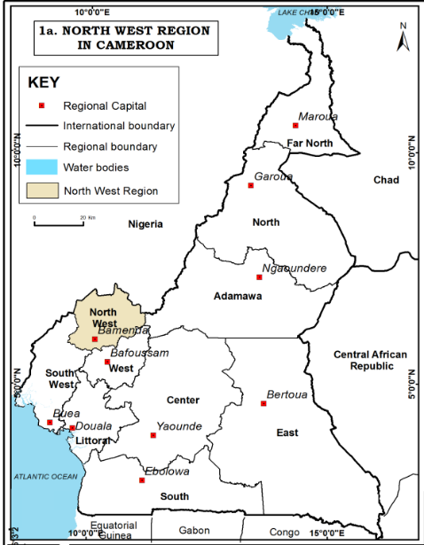
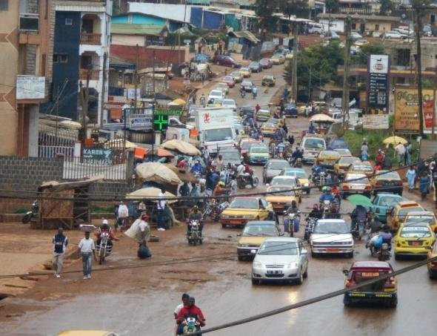
Bamenda, Cameroon
Notes:
Bamenda as an urban area with basic road design

Slide 18
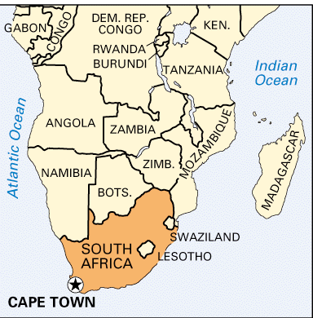
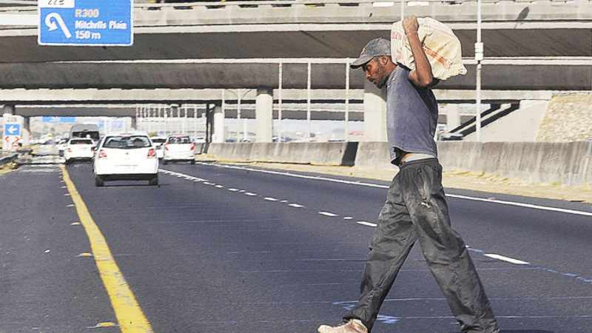
Cape Town, South Africa
Notes:
Cape Town as an urban area with automobile road design

Slide 19
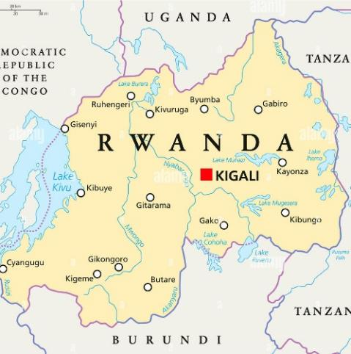
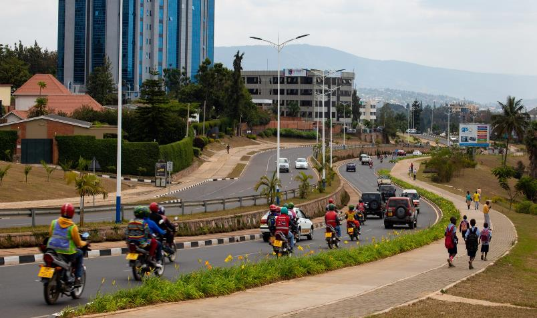
Kigali, Rwanda
Notes:
Kigali, striving towards more inclusive designs

Slide 20
Research design
Selection of two arterial roads in each city
Observation checklist on road design and use
Interviews with residents along each route
Focus groups with professionals and decision-makers

Slide 21
First case study: Kigali, Rwanda

Slide 22
Case study road 1: Nyabugogo-Gatsata

Slide 23
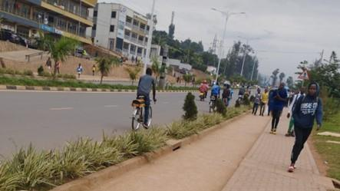
Modern design stretch of Nyabugogo-Gatsata road
Notes:
Take a look at these image

Slide 24
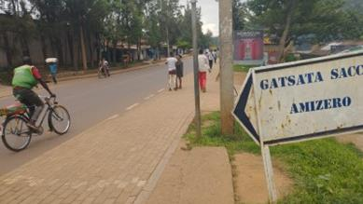
Basic design stretch of Nyabugogo-Gatsata road
Notes:
Take a look at these image

Slide 25
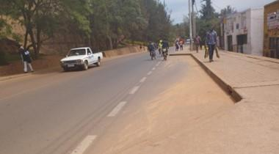
Notes:
Pavement on both sides and a bus stop

Slide 26
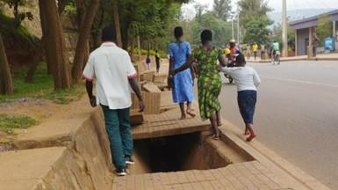
Notes:
Pavement on both sides and a bus stop

Slide 27
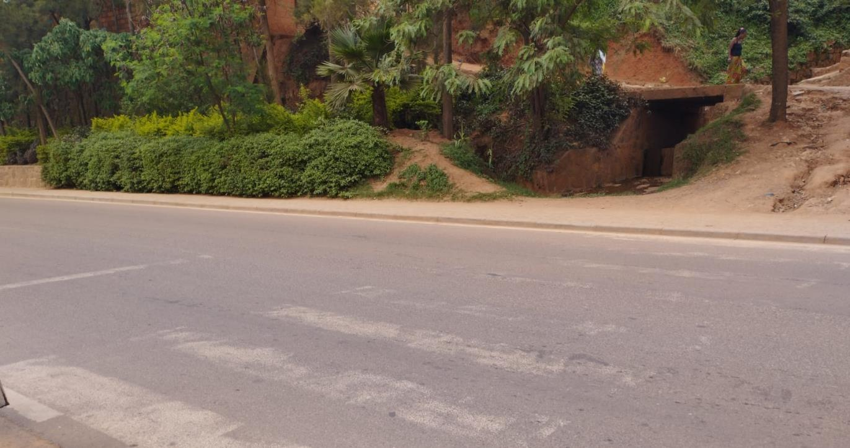
Notes:
Pavement on both sides and a bus stop

Slide 28
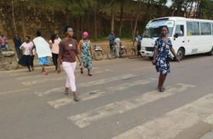
Notes:
Pedestrian behavior on crosswalk

Slide 29
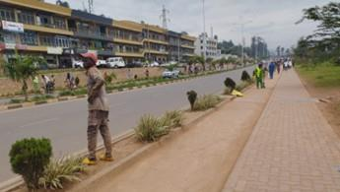
Notes:
Pedestrian behavior on pavement

Slide 30
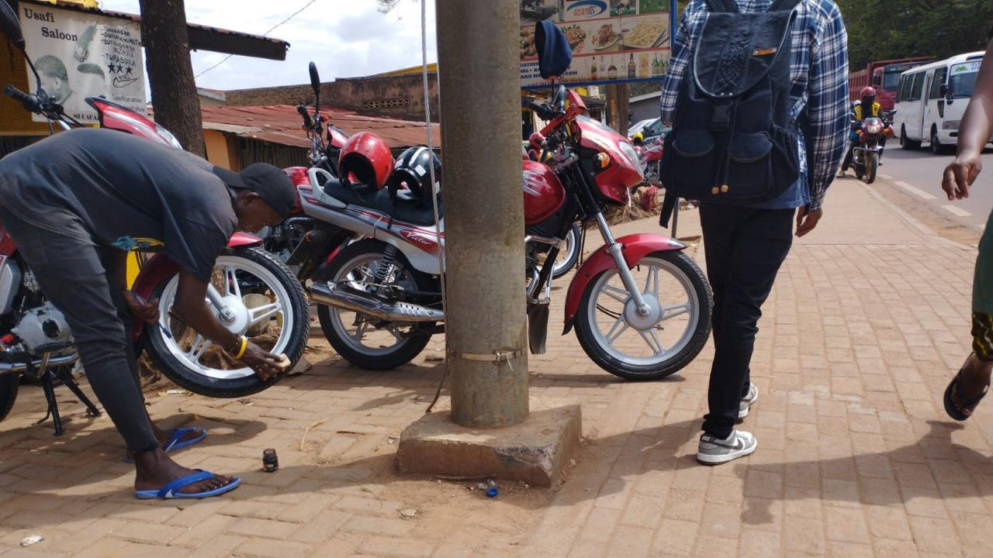
Notes:
Motorbike cleaning and tyre polishing

Slide 31
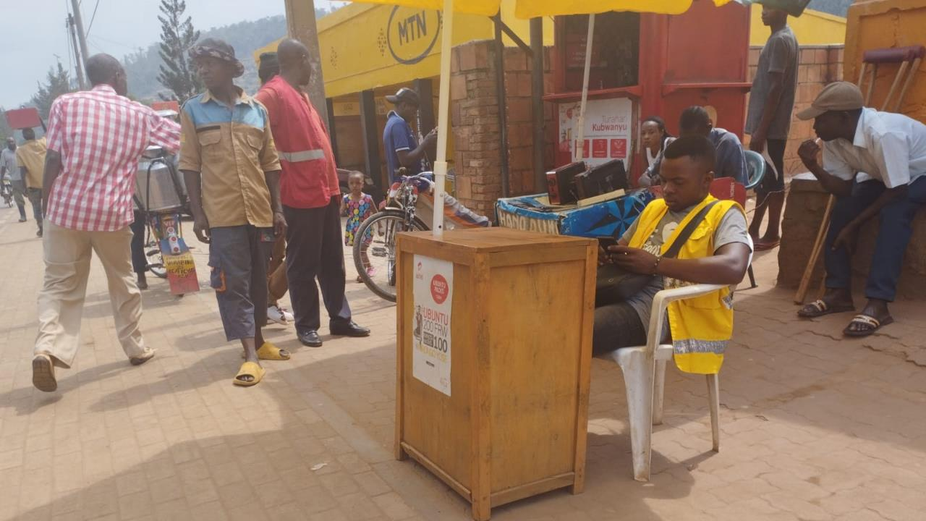
Notes:
Mobile money operator

Slide 32
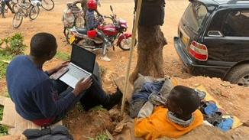
Notes:
Pedestrian behavior on pavement

Slide 33
Case study road 2: Rwandex-Sonatube

Slide 34
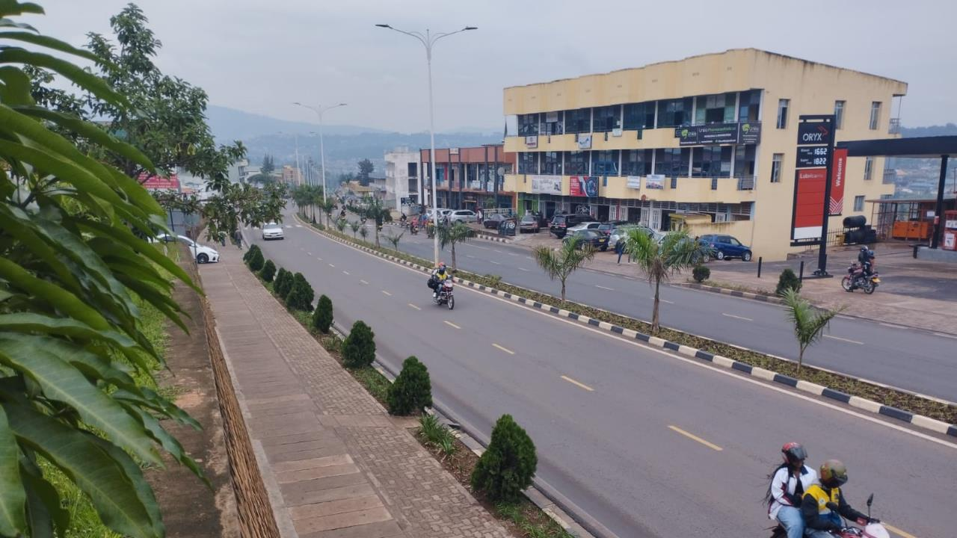
Notes:
Pedestrian behavior on pavement

Slide 35
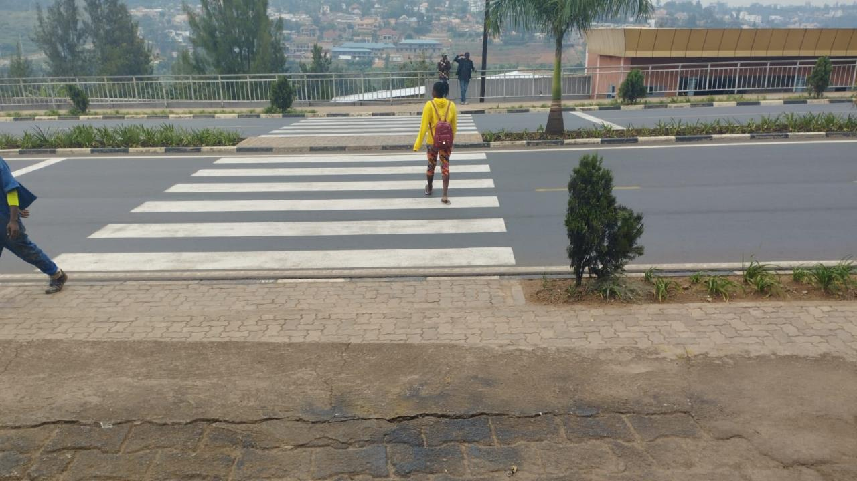
Notes:
Pedestrian behavior on pavement

Slide 36
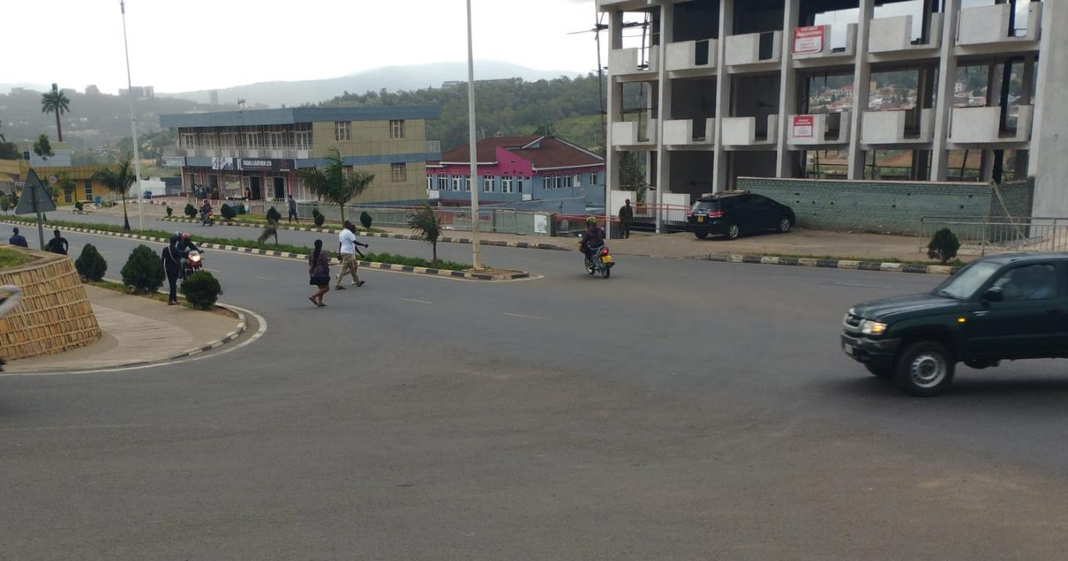
Notes:
Crossing at an unregulated point

Slide 37
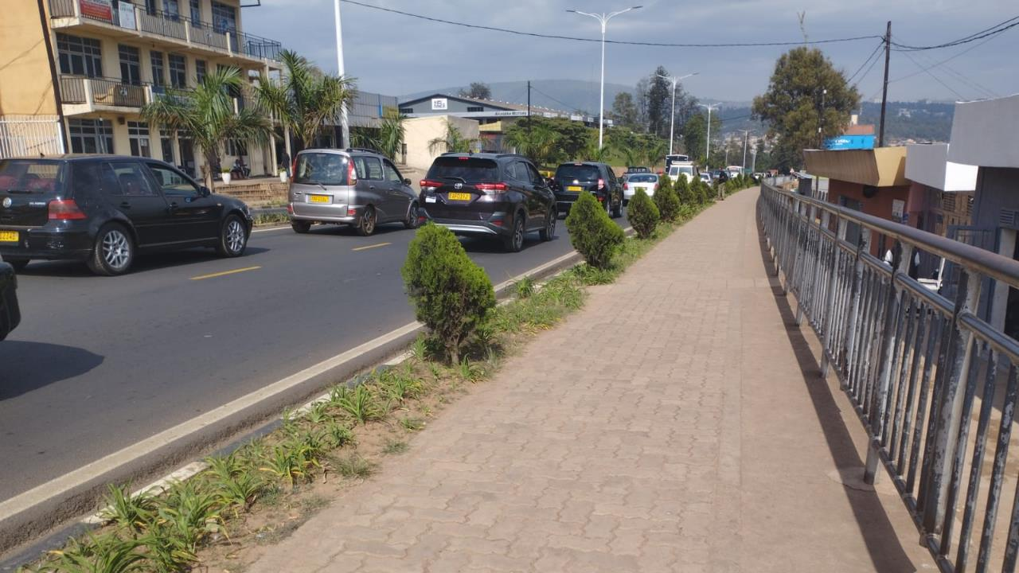
Notes:
Barrier at the edge of the sidewalk limiting easy access to the road

Slide 38
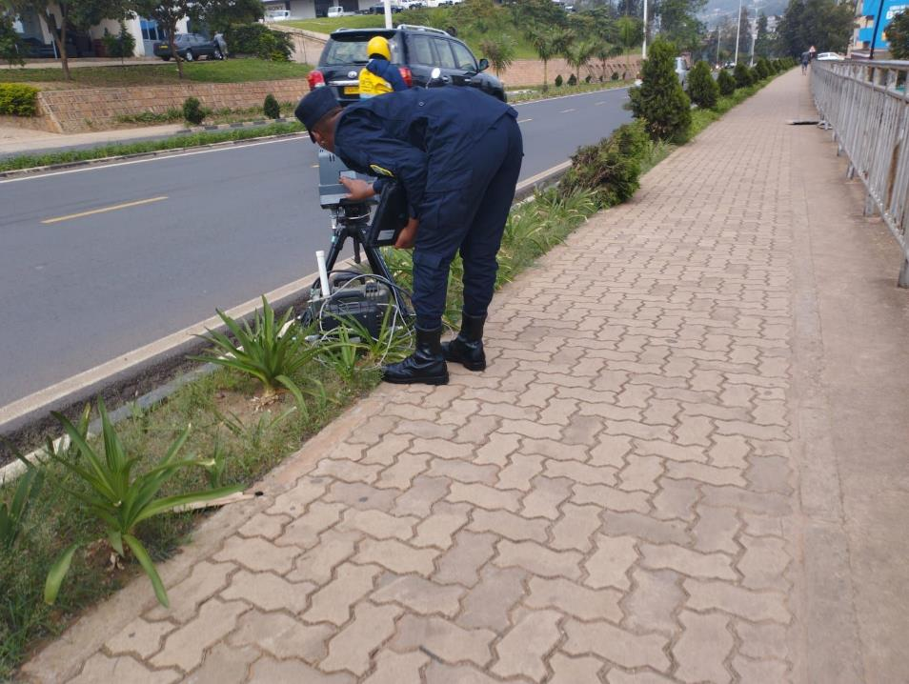
Notes:
Police on a speed tracking device

Slide 39
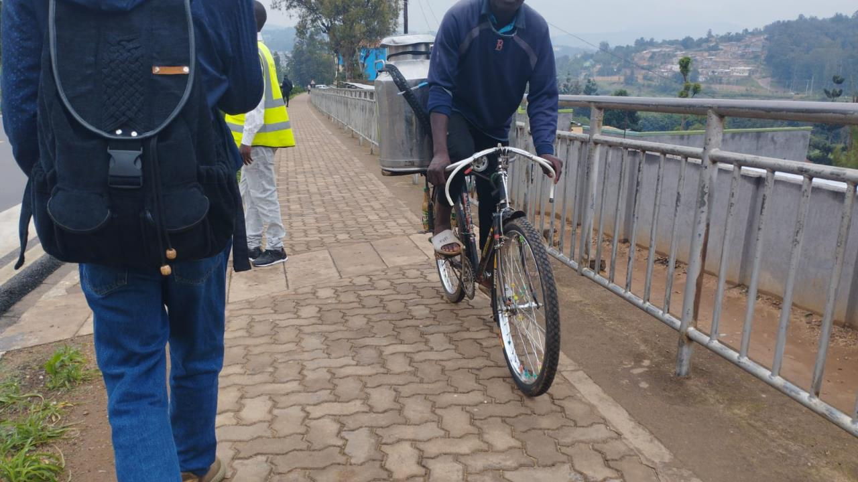
Notes:
Cyclists on sidewalk causing sidewalk friction

Slide 40
First findings
Notes:
Findings from interviews

Slide 41
Findings on mobility
Walking as the dominant transport mode
Most respondents walk over short distances but expressed the desire of walking over longer distance
Walking mostly due to financial constraints and for sports.
Frequent invasion of sidewalks by cyclists and occasionally by motorbikes.

Slide 42
Findings on accessibility
Most walking destinations were within 10-30 minutes
Friends and families on both side of the road but meet less frequent.
Cyclists, motorbikes and heavy trucks, were reported as common sources of discomfort during walking making some people to cross less.

Slide 43
Findings on livelihoods
Livelihood 1. Respondents reported:
Official restriction of informal livelihood activities.
Decline in business activities due to low exposure
Increase in house rents especially along the Rwandex-Sonatube road.

Slide 44
Findings on livelihoods
Livelihood 2. Small business owners reported:
On Gatsata: most costumers are local residents who walk.
On Rwandex: most customers are car owners, especially for businesses with parking premises.

Slide 45
Findings on roads as a place
Most respondents do not spend time along streets for leisure.
Jogging as only form of sport common.
Streets not used for social activities like funerals, marriages and birthdays.
Respondents report traffic crashes to be common.

Slide 46
Residents suggestions for road improvements
Road widening especially for Gatsata.
Traffic lights and road signs on both streets.
Provision of toilets along streets for road users.
Provision of rest stops, benches, and shelter.

Slide 47
Conclusion

Slide 48
Conclusion
Walking is dominant in the city but hinder by cyclists, motorbikes and trucks
Respondents positive about mode separation of recent road design
Respondents call for enhance walking facilities
Yet, also see motorisation as the future of transport.

Slide 49
Discussion
Car bias not only prevalent among stakeholder but also among urban poor
Yet, low motorisation levels remain inevitable for decades to come
Hence, critical debate transport future inevitable
Shift from ‘stroad’ to inclusive road designs remain essential in SSA

Slide 50
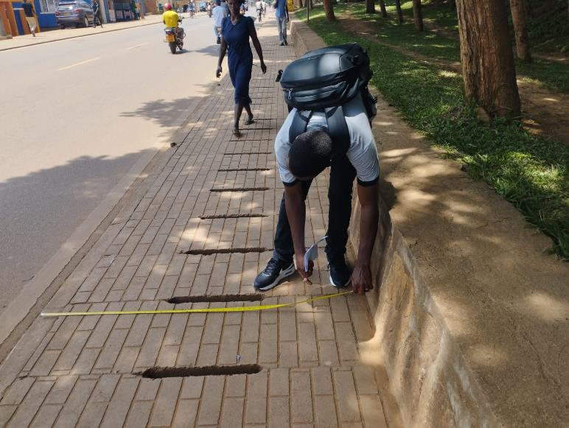
Thank you for your attention
Questions?
Notes:
Cape Town as an urban area with automobile road design

